Slide 1
Advanced Prototyping and Evaluation
Notes for next time
Explain triangulation approach Use multiple methods to get to the truth of things
PACO for diary studies
https://www.pacoapp.com/
Difference between what people think and what they will do
Ex. Leysia’s study on mobile phone users
Add loss aversion for diary studies
Add mention of optimizely and Google Optimize
Programming Usable Interfaces (PUI)
Jason Hong
Notes:
Video to preload: https://www.youtube.com/watch?v=t5X2PxtvMsU

Slide 2
Today
Advanced prototyping and evaluation
Prototyping Augmented Reality / IoT
3-2-1 Process for Prototyping
A/B User Testing
Why?
Most of what we’ve discussed is desktop-oriented
Augmented Reality / IoT becoming more common
Useful methods for BHCI and MHCI capstone courses and for practice
Will show lots of examples of what folks have done in the past

Slide 3
NASA Capstone 2014 Helios
A system to help NASA engineers (on ground) and astronauts (in space) track and share information about tasks
Streamline procedure execution
Share status information (for coordination)
Locate tools (assumes locators on tools)
Ideally on the person
So Smartphone app or Wearable
Opted for wearable since looking forward

Slide 4
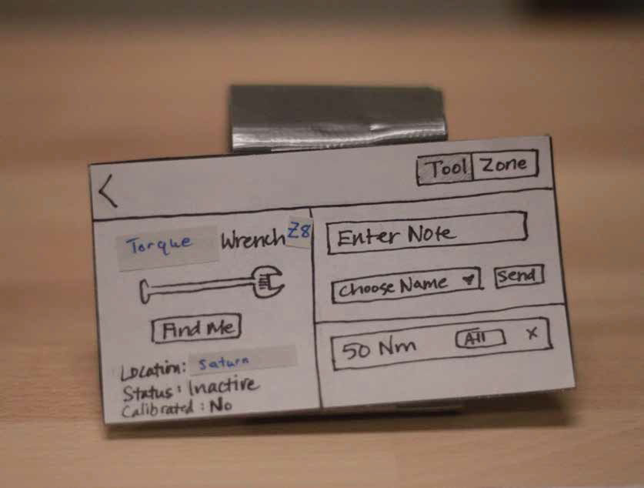
NASA Capstone 2014 Helios
Notes:
First paper prototype
Wearable computer on wrist
Can see information about where tools are, add notes too

Slide 5
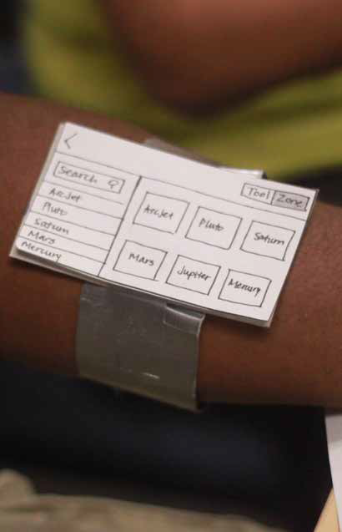
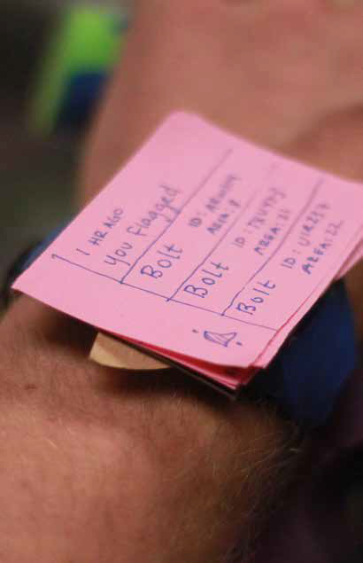
Notes:
Example prototype from Helios NASA team

Slide 6
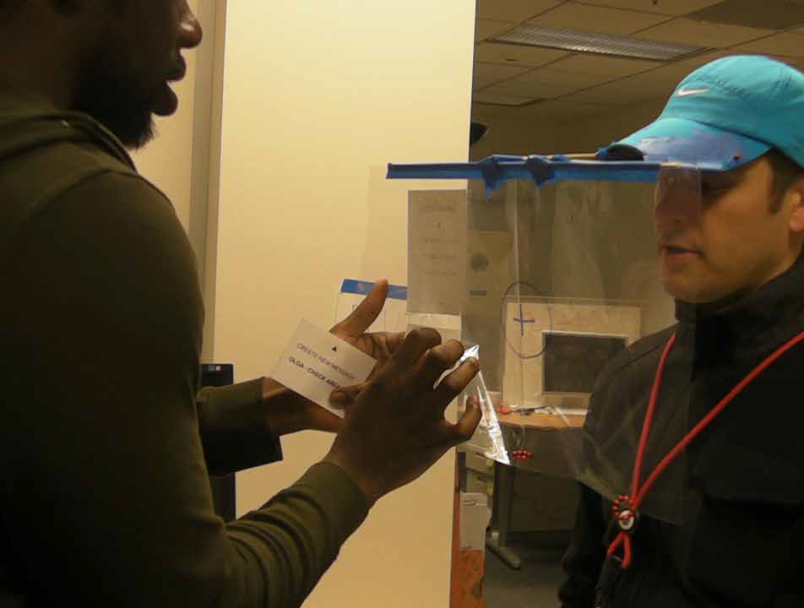
Notes:
Augmented reality mockup using transparencies and a hat

Slide 7
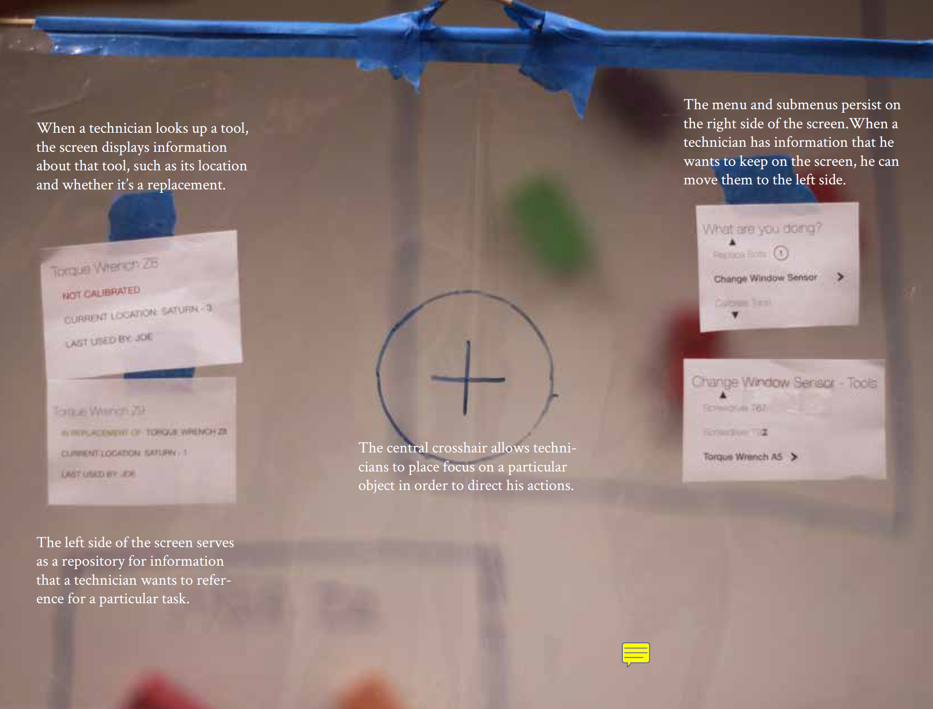
Notes:
Annotated version of what user sees
Note that this figure isn’t that great b/c it’s hard to tell what the user would see and what is the annotation

Slide 8
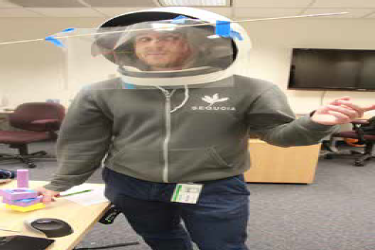
Notes:
Next iteration of the augmented reality view
Note the mockup of the space helmet

Slide 9
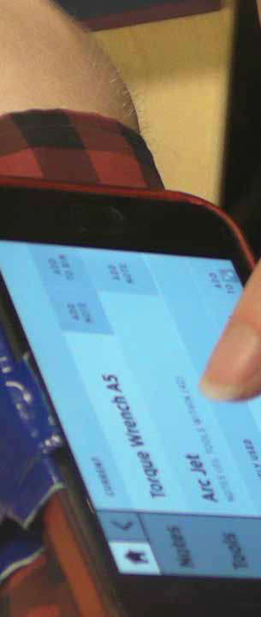
Notes:
Next iteration of the mockup, this time using an iPhone duct taped to the wrist

Slide 10
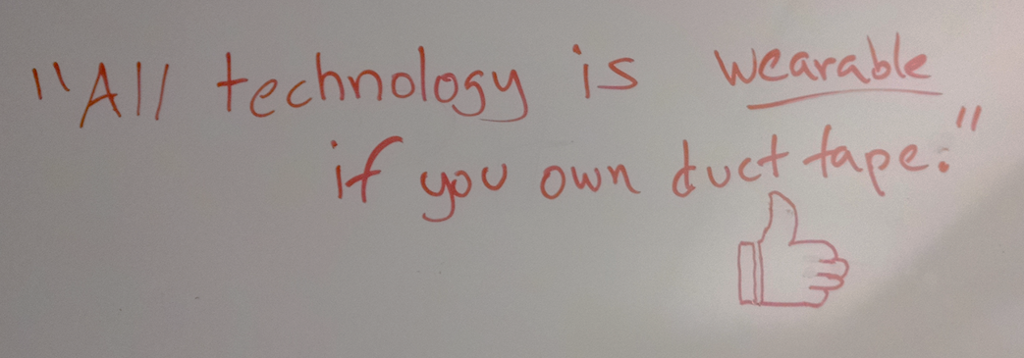
Prototyping Philosophy
Have to be creative to do low-fi prototypes
Notes:
Have to be creative (this was on the team’s whiteboard)

Slide 11
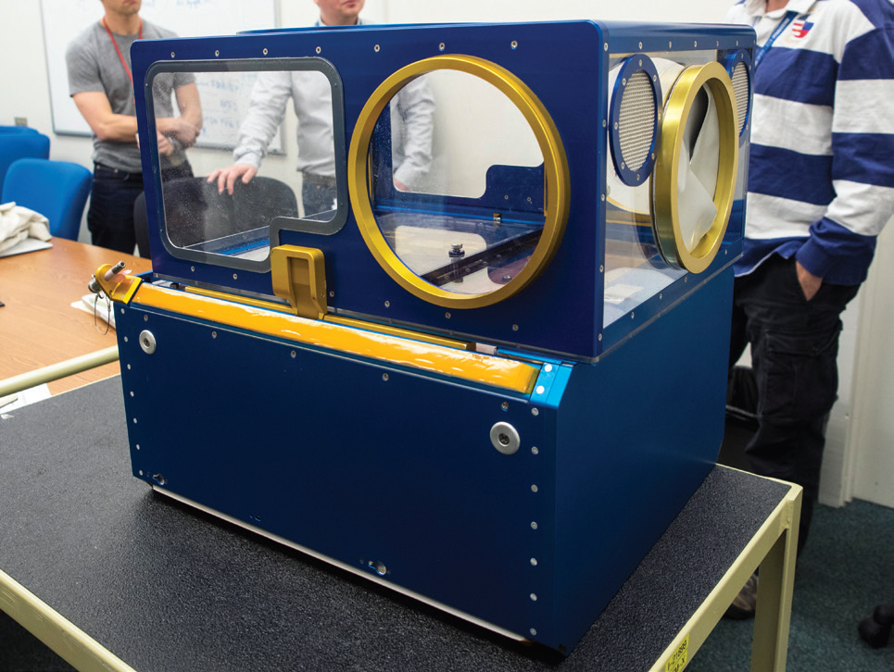
NASA Capstone 2015 Rats in Space
Help astronauts do procedure execution
Might be something trained on years ago
Rodent habitat

Slide 12
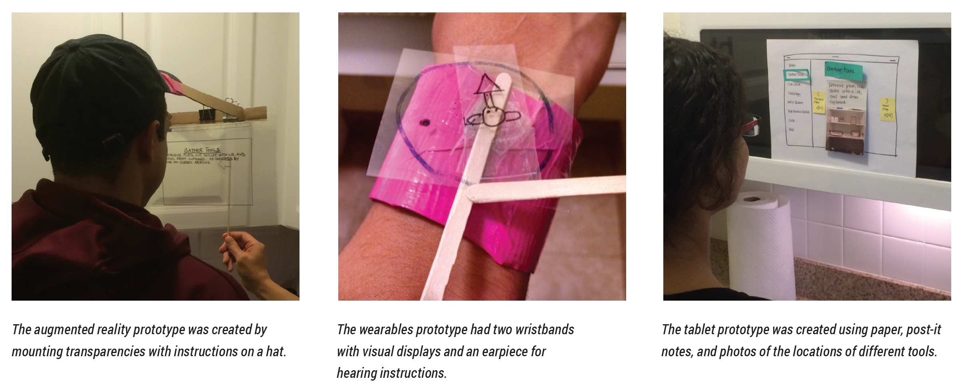
NASA Capstone 2015 Rats in Space
Notes:
More mockups of AR, again using transparencies
One on the left gives instructions in front of the person
Middle one shows a watch-based UI
Third one is a display on the wall

Slide 13
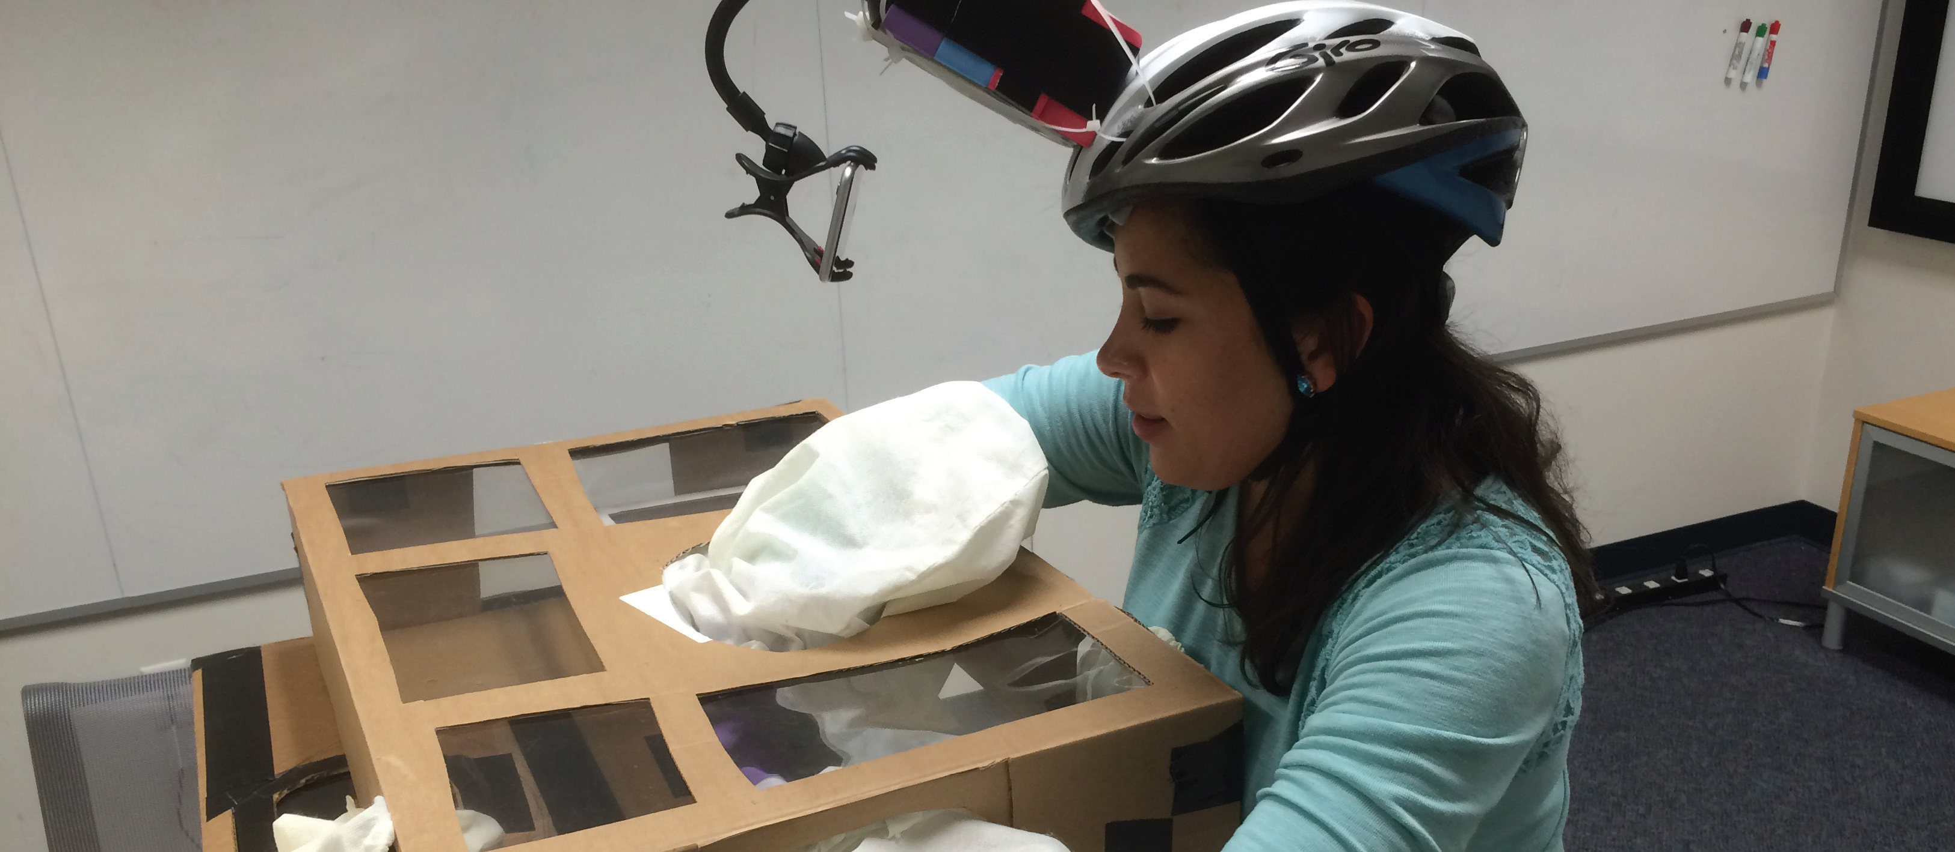
Notes:
Bike helmet rigged to hold an iphone in front
Note the mocked up rodent habitat
Speech-based hands-free UI

Slide 14
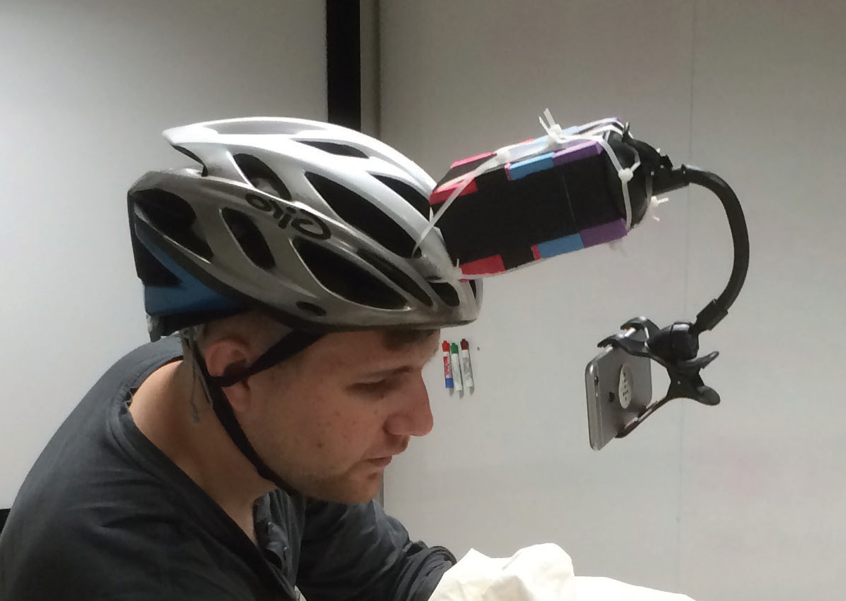
Notes:
Same bike helmet

Slide 15
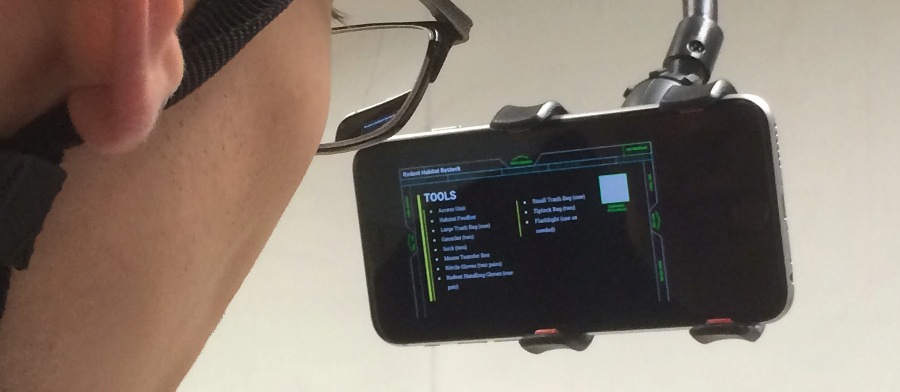

Slide 16
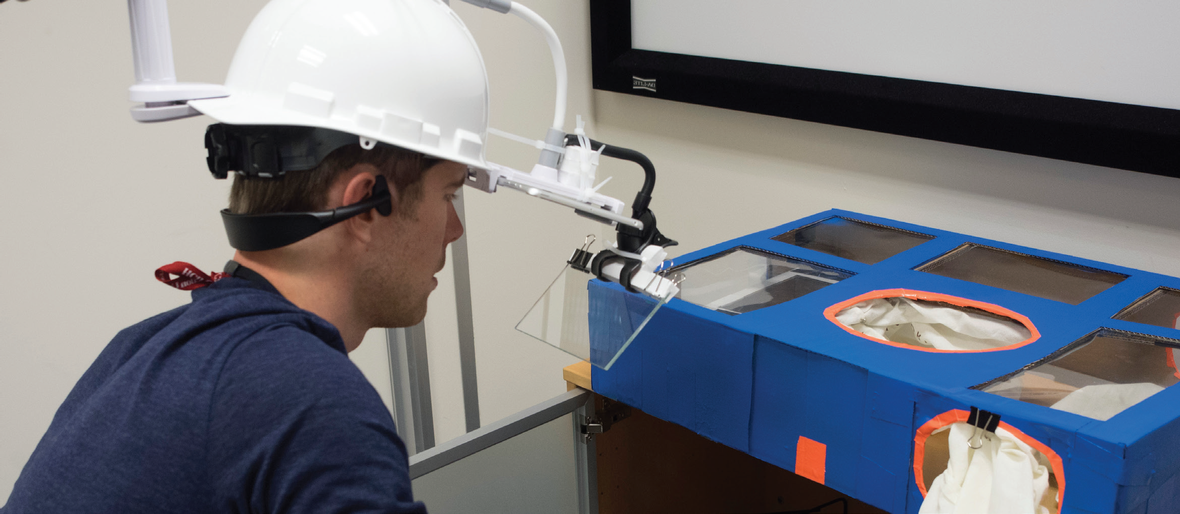
Notes:
Next prototype, used reflection, tablet is horizontal and at eye level

Slide 17
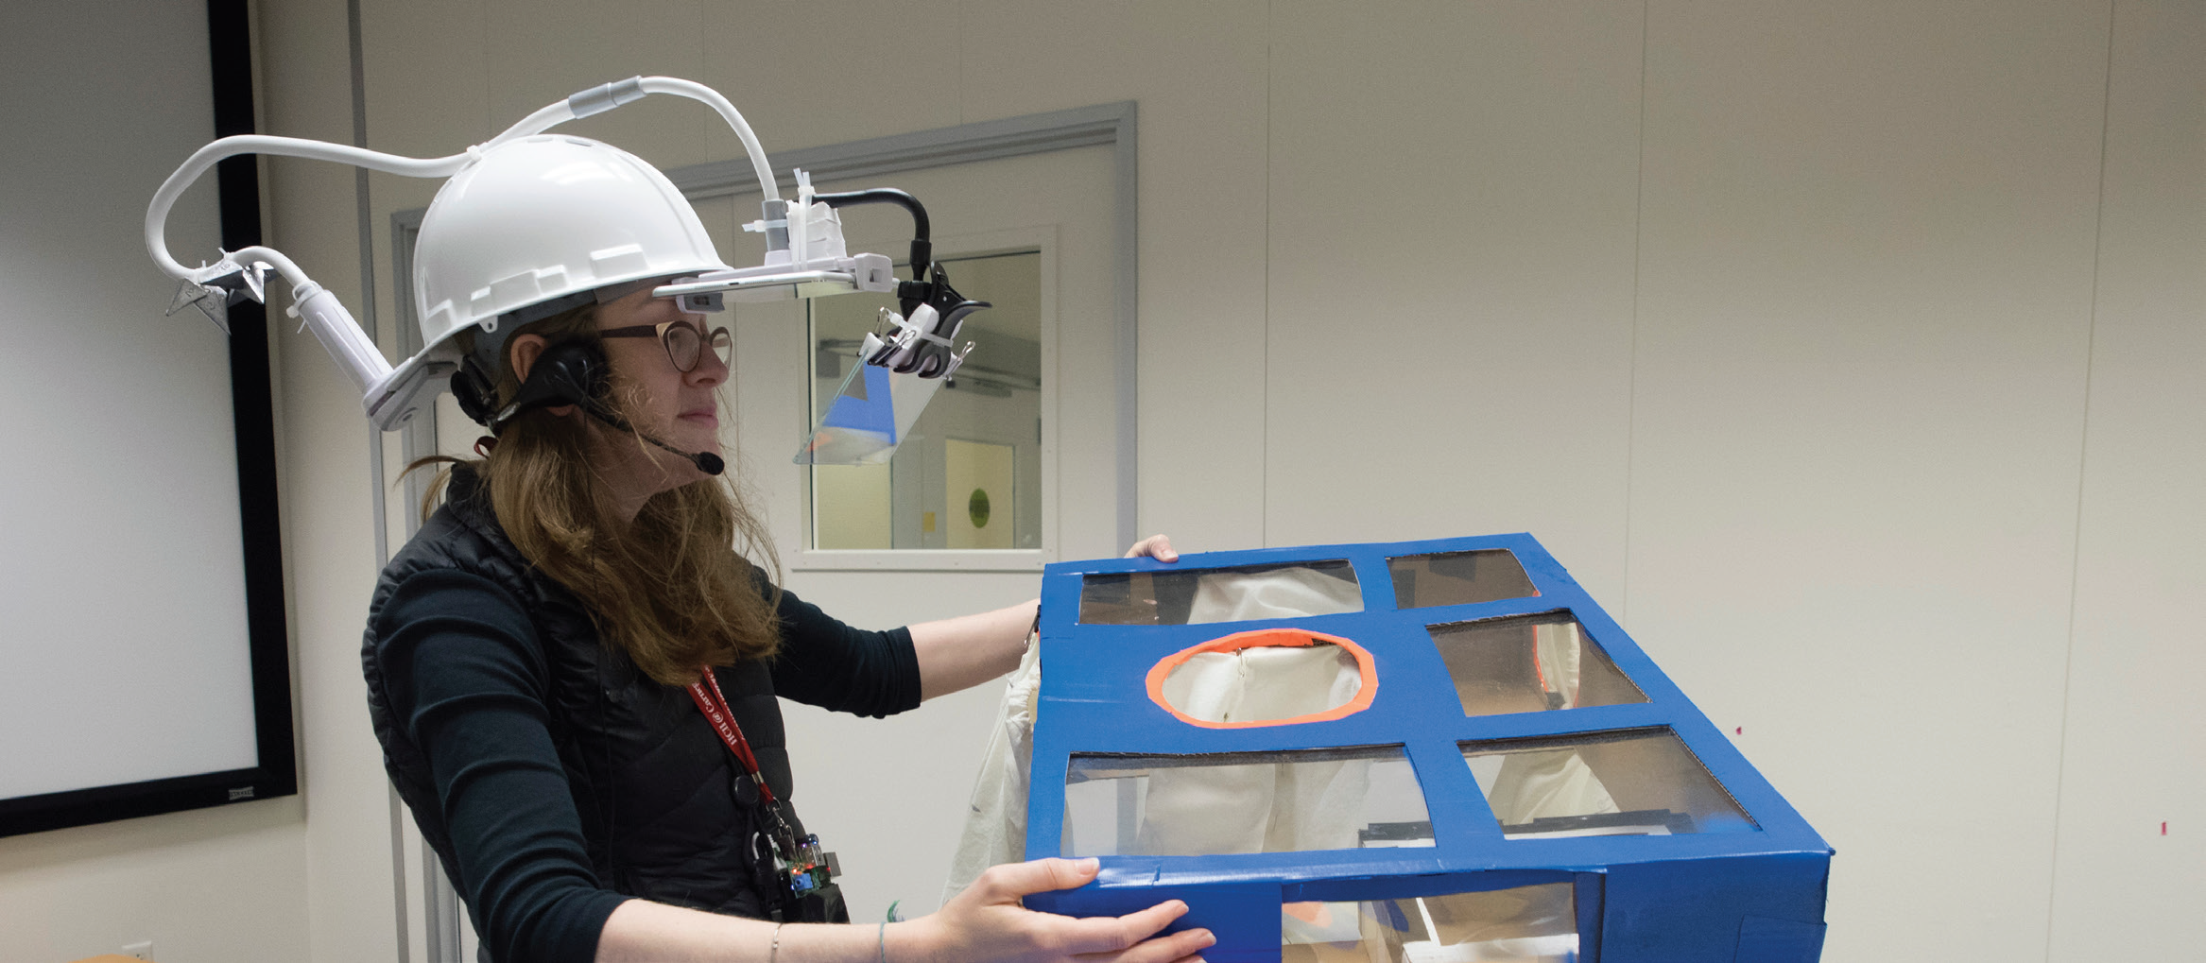

Slide 18
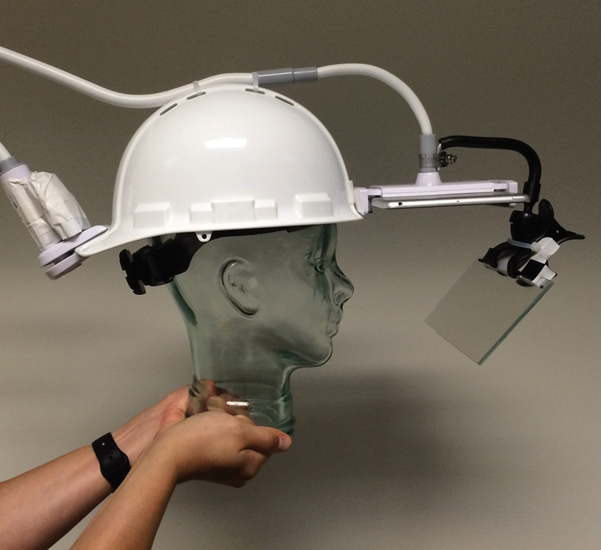

Slide 19
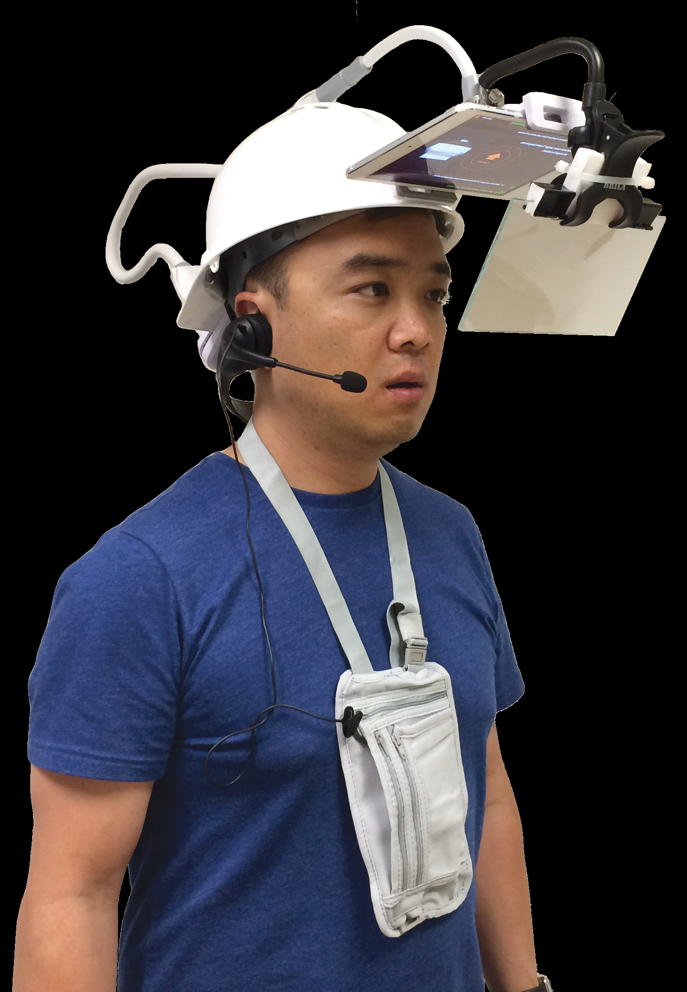
Notes:
Full UI with speech-based input (wizard of Oz)
Ron

Slide 20
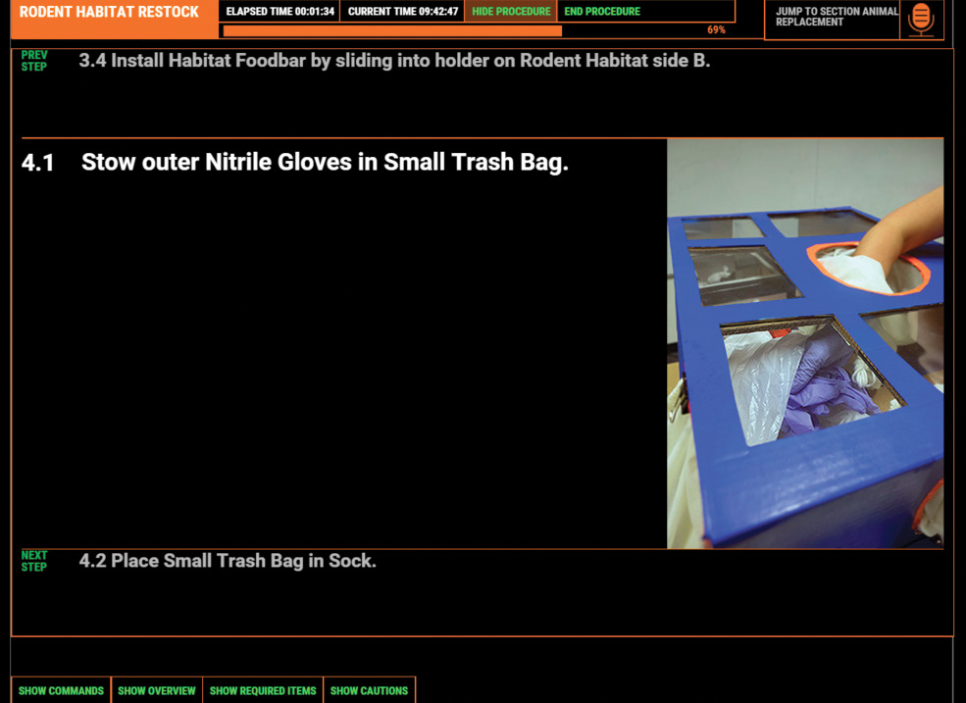
Notes:
Here is example of what user sees

Slide 21
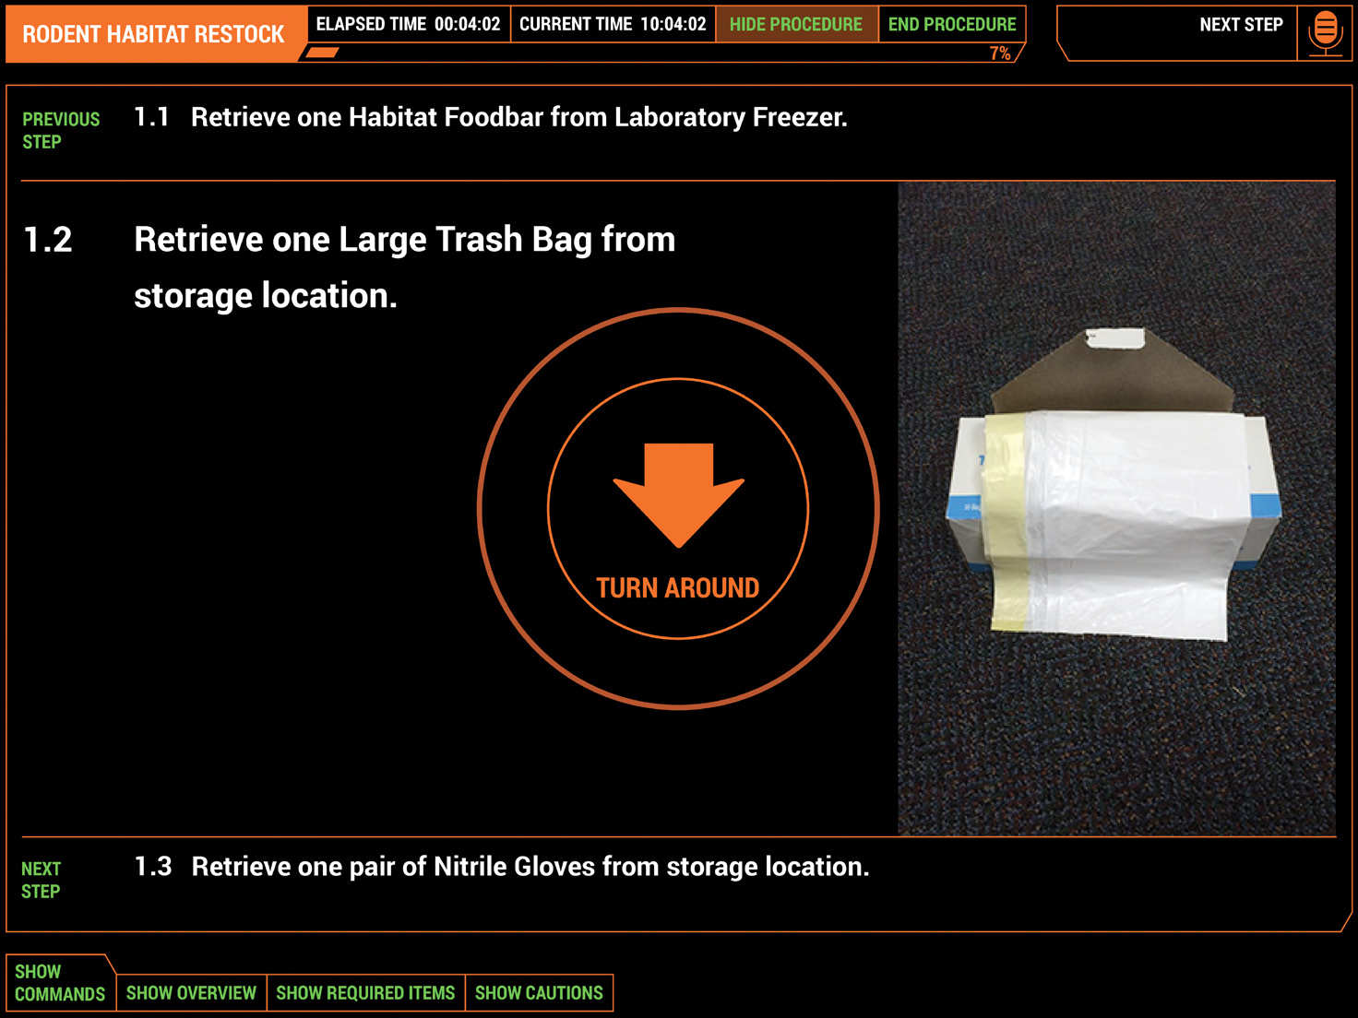
Notes:
Gives locator information, in this case turn around

Slide 22
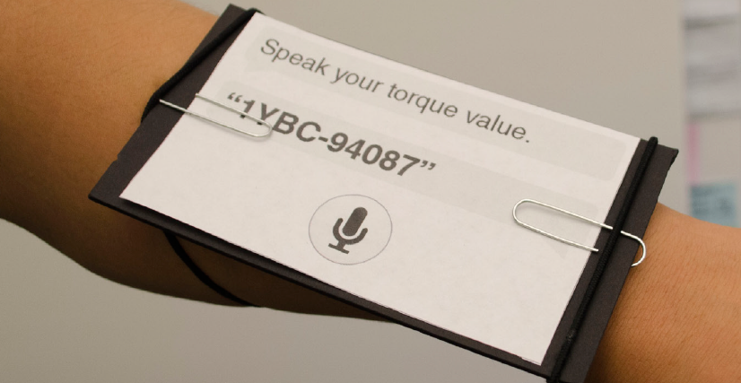
Boeing 2014 MHCI Capstone Wearable for Contextual Info Access
Notes:
Streamlining communications on the factory floor for constructing 737s
Helping factory workers on the floor
Explored lots of different ideas
Here is a wearable for getting just-in-time information instead of having to lug around manuals
Can also reduce paper use (printing out info that a worker needed)

Slide 23
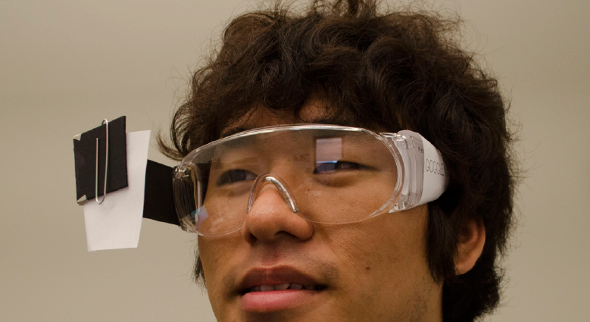
Boeing 2014 MHCI Capstone Knowledge Sharing Platform
Notes:
Sort of like Twitch.tv but for factory workers
Capture knowledge about how to do things, especially since lots of folks were retiring
Matthew Hong

Slide 24
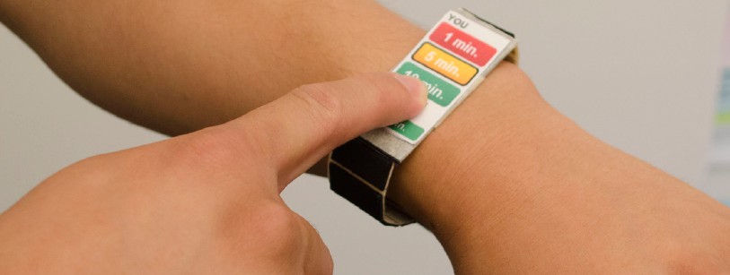
Boeing 2014 MHCI Capstone Job Completion Notifications
Notes:
Might have a task assigned to you, want to easily share with others on the factory floor how long you think it will take you, to streamline the pipeline (instead of having people do QA at the end of each shift, can pipeline it all)

Slide 25
Bosch 2014 Internet of Things for Homes
Make it easy to manage and connect IoT devices with each other in home
Ex. Add new IoT device to the home
Ex. Link refrigerator events to your phone
Ex. Have scripts, like morning coffee

Slide 26
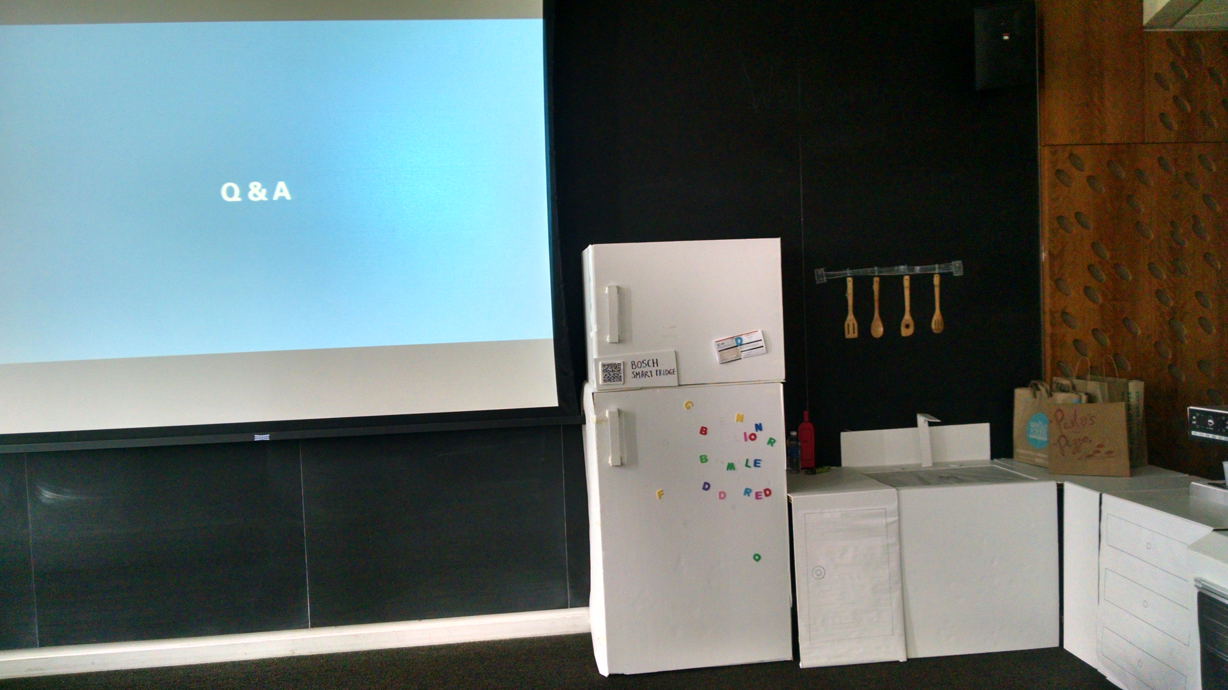
Notes:
They created a fake house, foamcore and cardboard
Brought it in for their final presentation
You can see the fridge (with QR code), sink, oven, etc

Slide 27
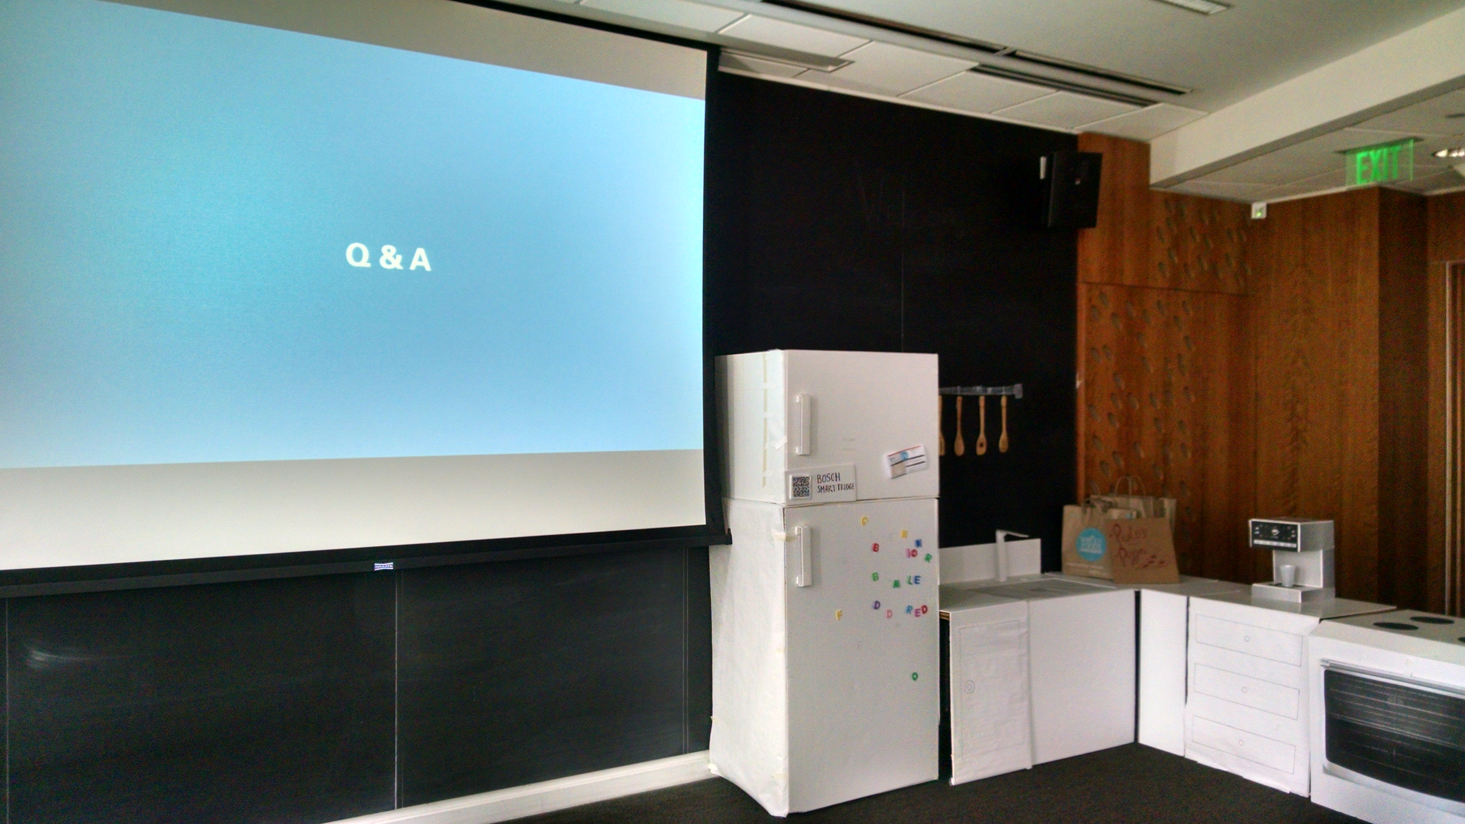

Slide 28
Google 2014 - Signifiers.io
How to have physical devices offer privacy feedback?
On? Recording? Tracking you?
Check out web site, report is publicly available
Notes:
Signifiers.io

Slide 29
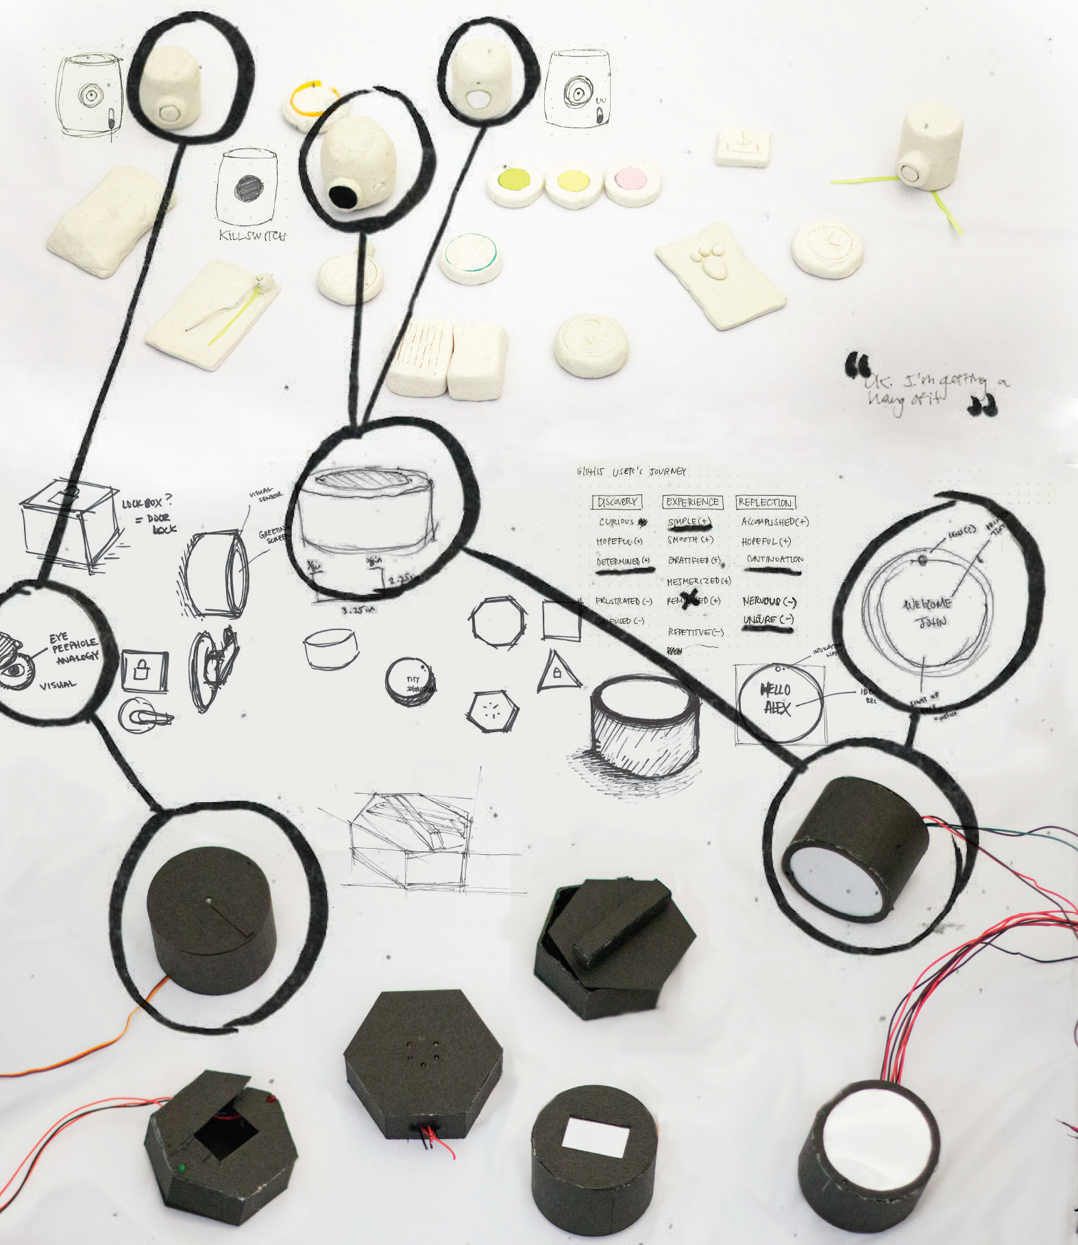

Slide 30
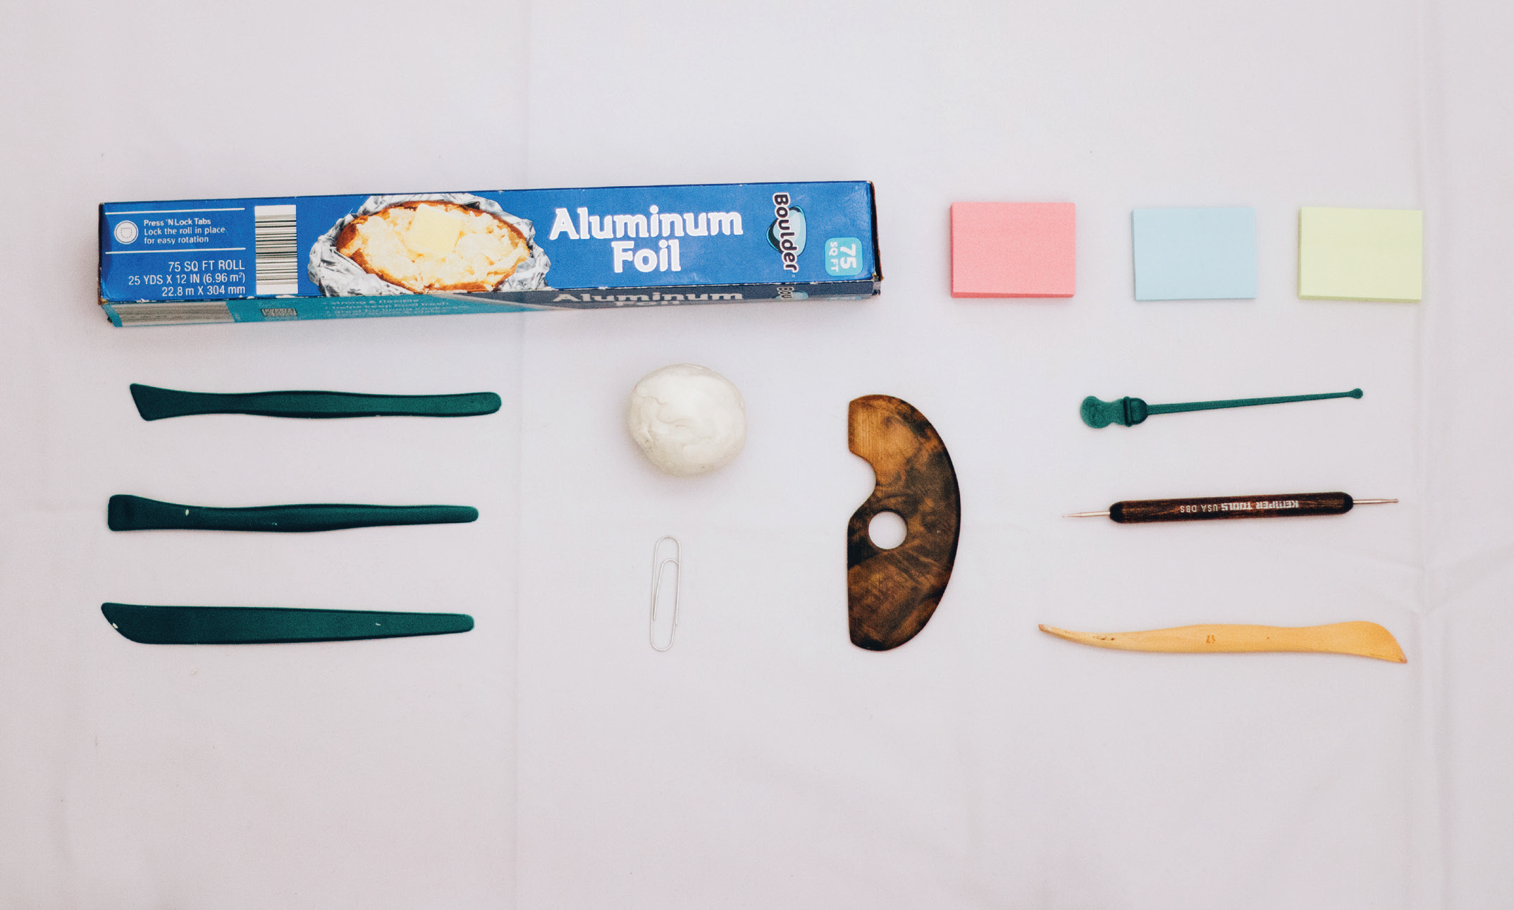
Notes:
Did lots of clay prototypes of physical feedback mechanisms

Slide 31
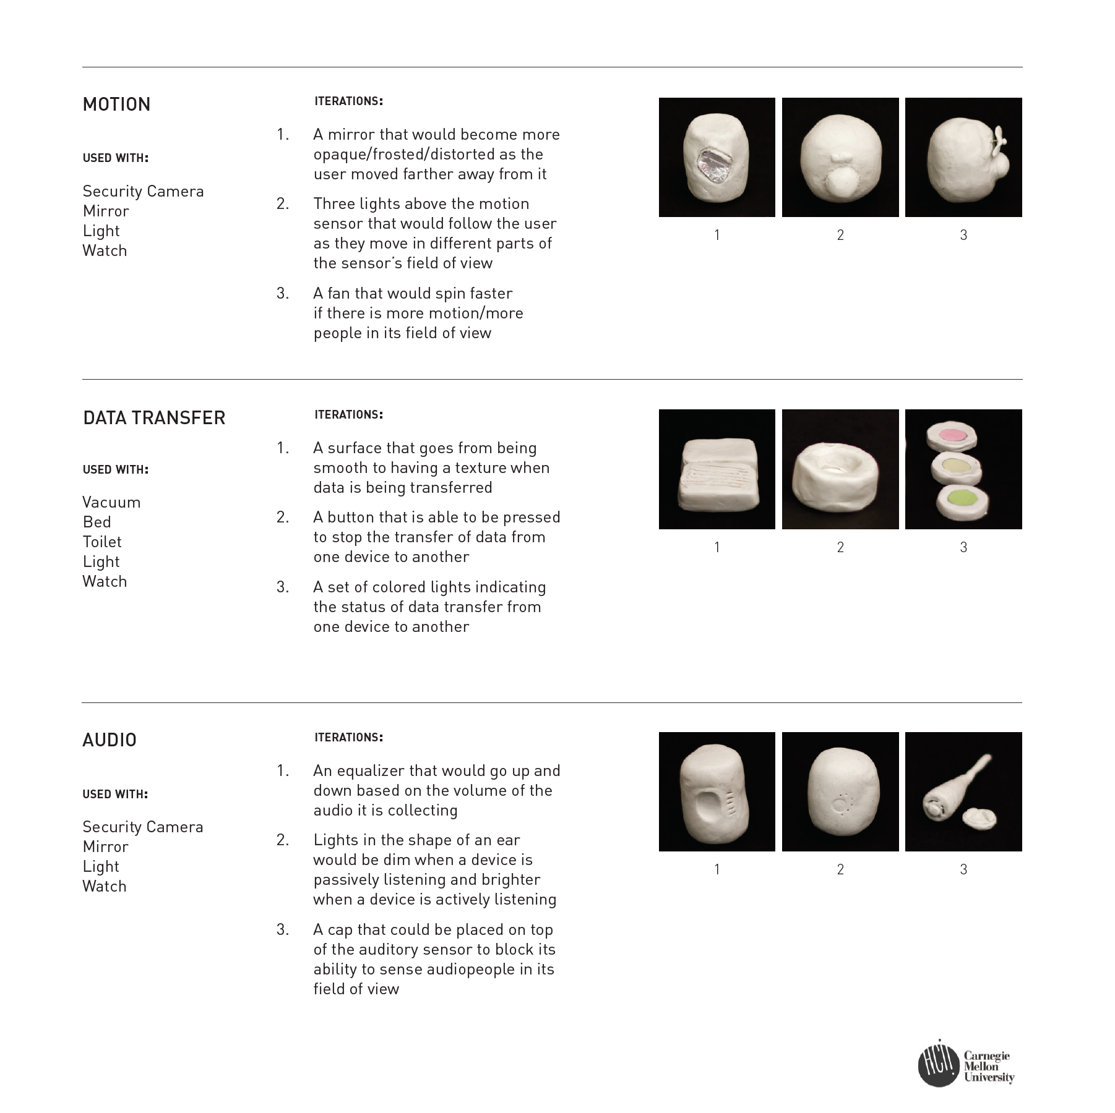

Slide 32
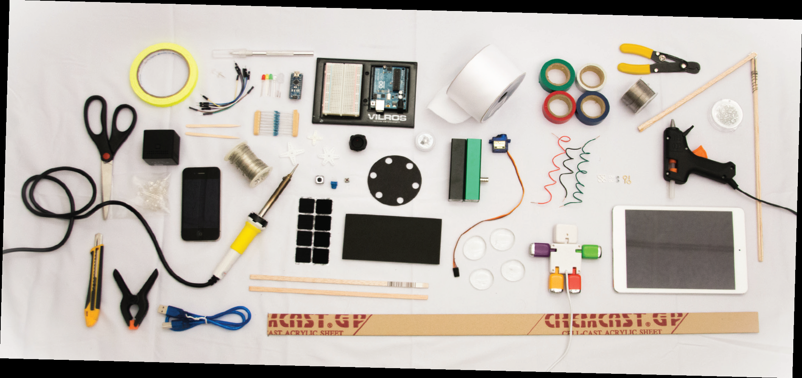
Notes:
And then built some faux electronic devices

Slide 33

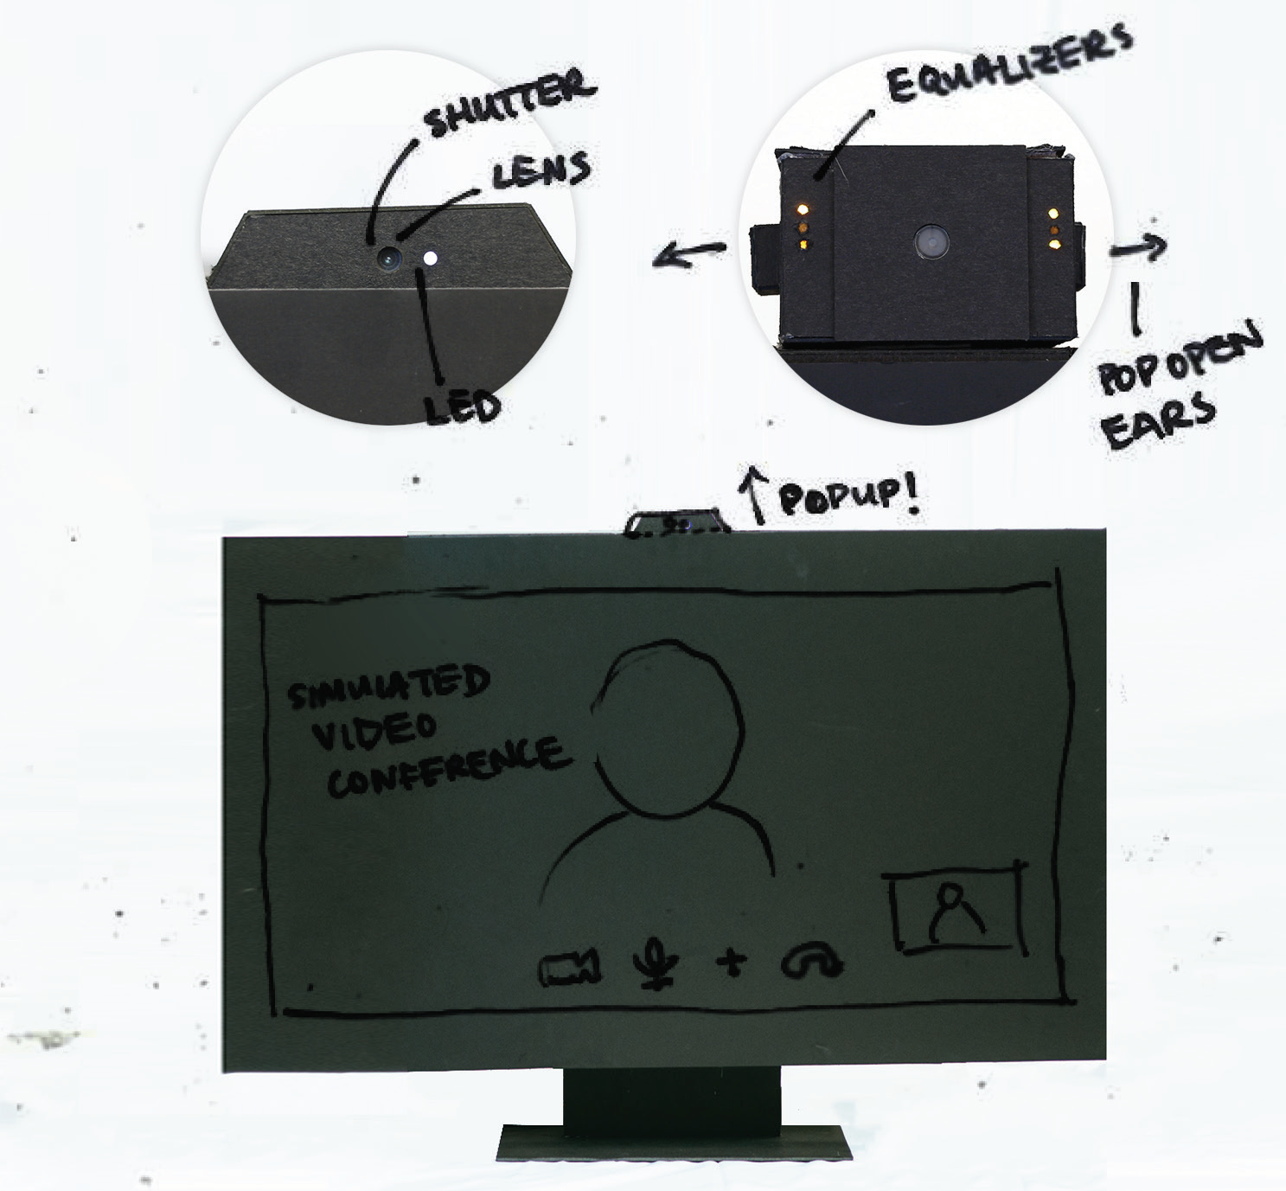

Slide 34
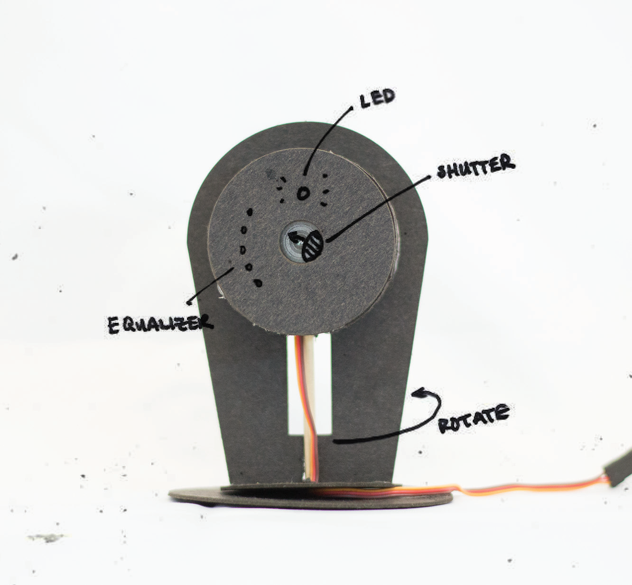

Slide 35
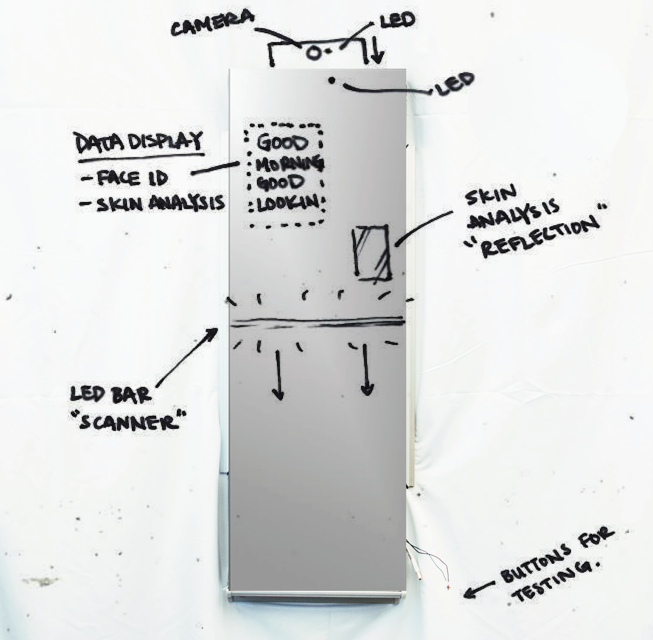
Notes:
Smart mirror concept

Slide 36
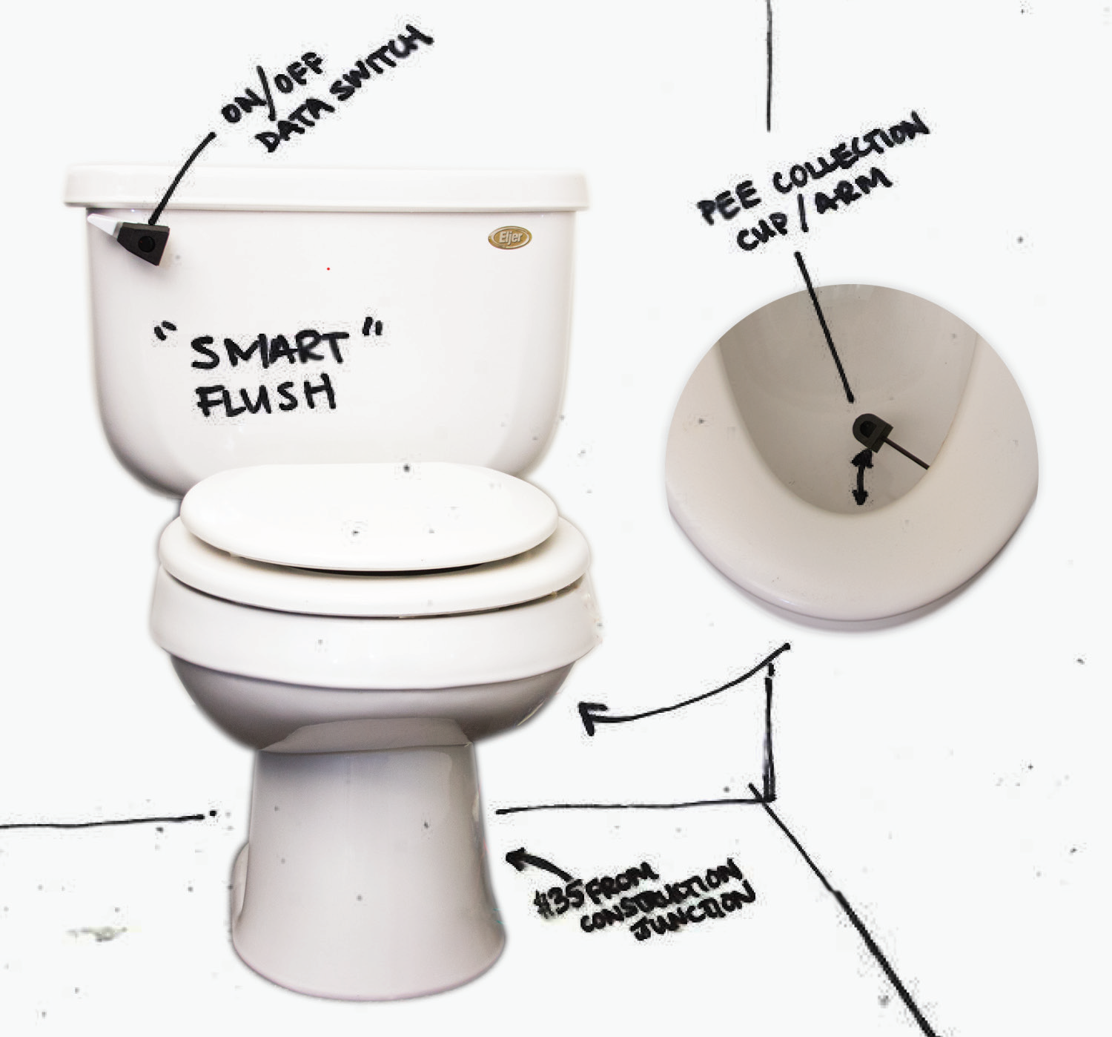
Notes:
Even bought a toilet (and had it in MHCI space)

Slide 37
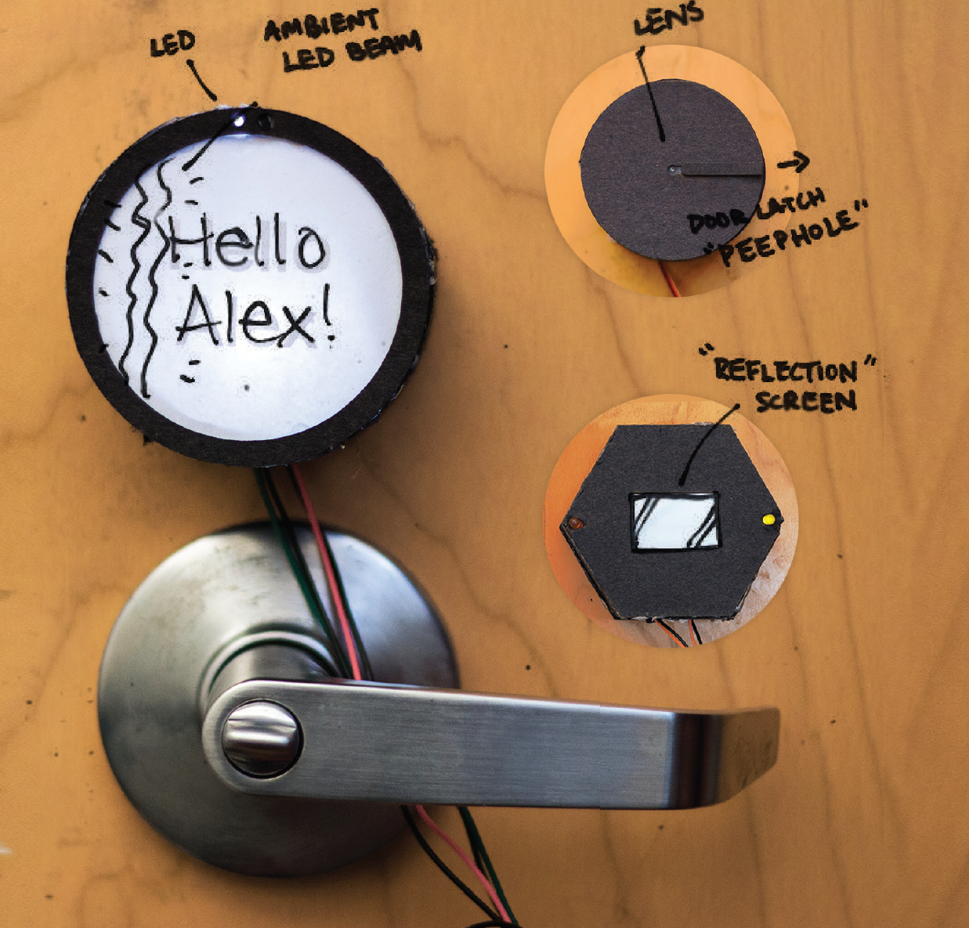
Notes:
Smart door lock
A door lock that is connected to the internet, and can be unlocked remotely. Some versions have a camera.

Slide 38
Diary Studies / Experience Sampling
Another way to understand behavior over a long period of time
Diary studies have been used to:
Ex. How people spend their time
Ex. With whom they socialize
Ex. What they eat
Ex. How often people feel bored
Ex. What info needs people have when mobile

Slide 39

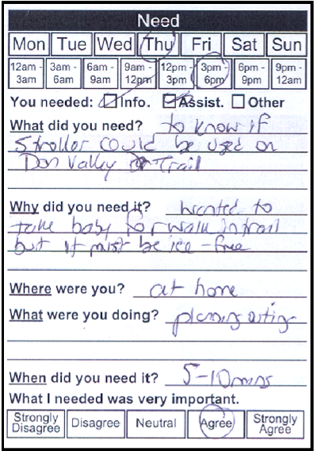
Notes:
A study of mobile information needs (Khai Truong et al)
Every time you need some info, write it down

Slide 40
Diary Studies / Experience Sampling
Interval-based – Record at regular times
Signal-based – Record when prompted
Ex. beeper or PDA
Event-based – Record when event happens, useful for rare events
Ex. Every time you use a password
Retrospective
Ex. At end of each day, how well your plan matched your planned schedule

Slide 41
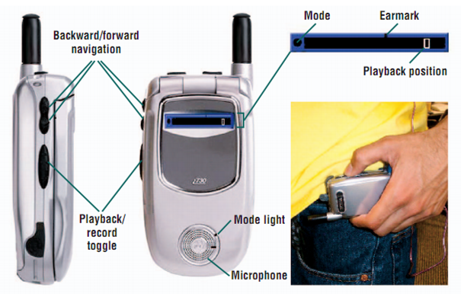
Example: Personal Audio Loop
Notes:
Prototypes and Paratypes:
Designing Mobile and
Ubiquitous Computing
Application

Slide 42
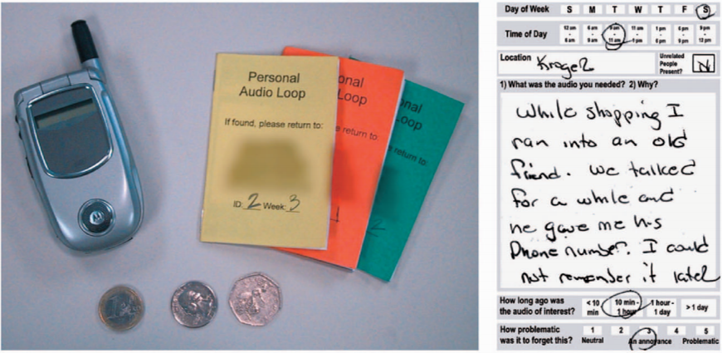
Example: Personal Audio Loop
Notes:
Prototypes and Paratypes:
Designing Mobile and
Ubiquitous Computing
Application

Slide 43
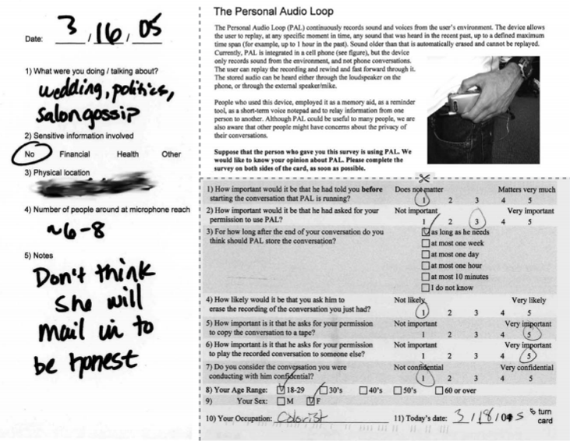
Example: Personal Audio Loop
Notes:
Prototypes and Paratypes:
Designing Mobile and
Ubiquitous Computing
Application

Slide 44
Discussion of Diary Studies / ESM
Pros and Cons of diary studies vs lab studies?
- Diary studies – might have low compliance
+ Diary study – is in own environment
+ Diary – not someone to watch you / Hawthorne effect
+ Diary – more long-term understanding of behaviors
- Diary – might be based on recall (fuzzy memory)
- lab studies – need to schedule time
- both / possibility of fatigue
+ diary / insights that can’t get from lab studies
Triangulate
Notes:
Burden
Altering user behavior
From 2016
Con: motivations to do this (might be lot of work)
Con: Might miss external forces
Con: Act of diary might change behaviors
Con: Time / money issues (might not get right set of people)
Pro: fewer recall errors
Pro: rich data
Notes from last time
Certain subset of people likely to respond
Loss aversion / incentives
Personal relationship / more willing to fill it out
Might not record trivial things
Giving something to people that they have to complete
People might lie / quality of information
Affect people’s behavior (positively / negatively)
Organizing diary study for neutrality (don’t want to encourage or discourage behaviors to study)
- Possible to misinterpret info
- Compliance can be hard
- Potential for annoying folks / burden
- Might require working technology
+ See people’s behaviors over long periods of time
+ Potentially generalizable
+ Mitigates some potential issues with retrospective interviews / retrospectives in general

Slide 45
Administrivia
HW3 due Wed Sep19, HW4 due Fri Sep21
Next class: Design patterns
Browse through these two sites before class:
User Interface Design Patterns Library http://ui-patterns.com/patterns
Android Patterns http://unitid.nl/androidpatterns/
We’re starting JavaScript next week
Voter registration deadline for PA is Oct 9
www.votespa.com for online registration

Slide 46
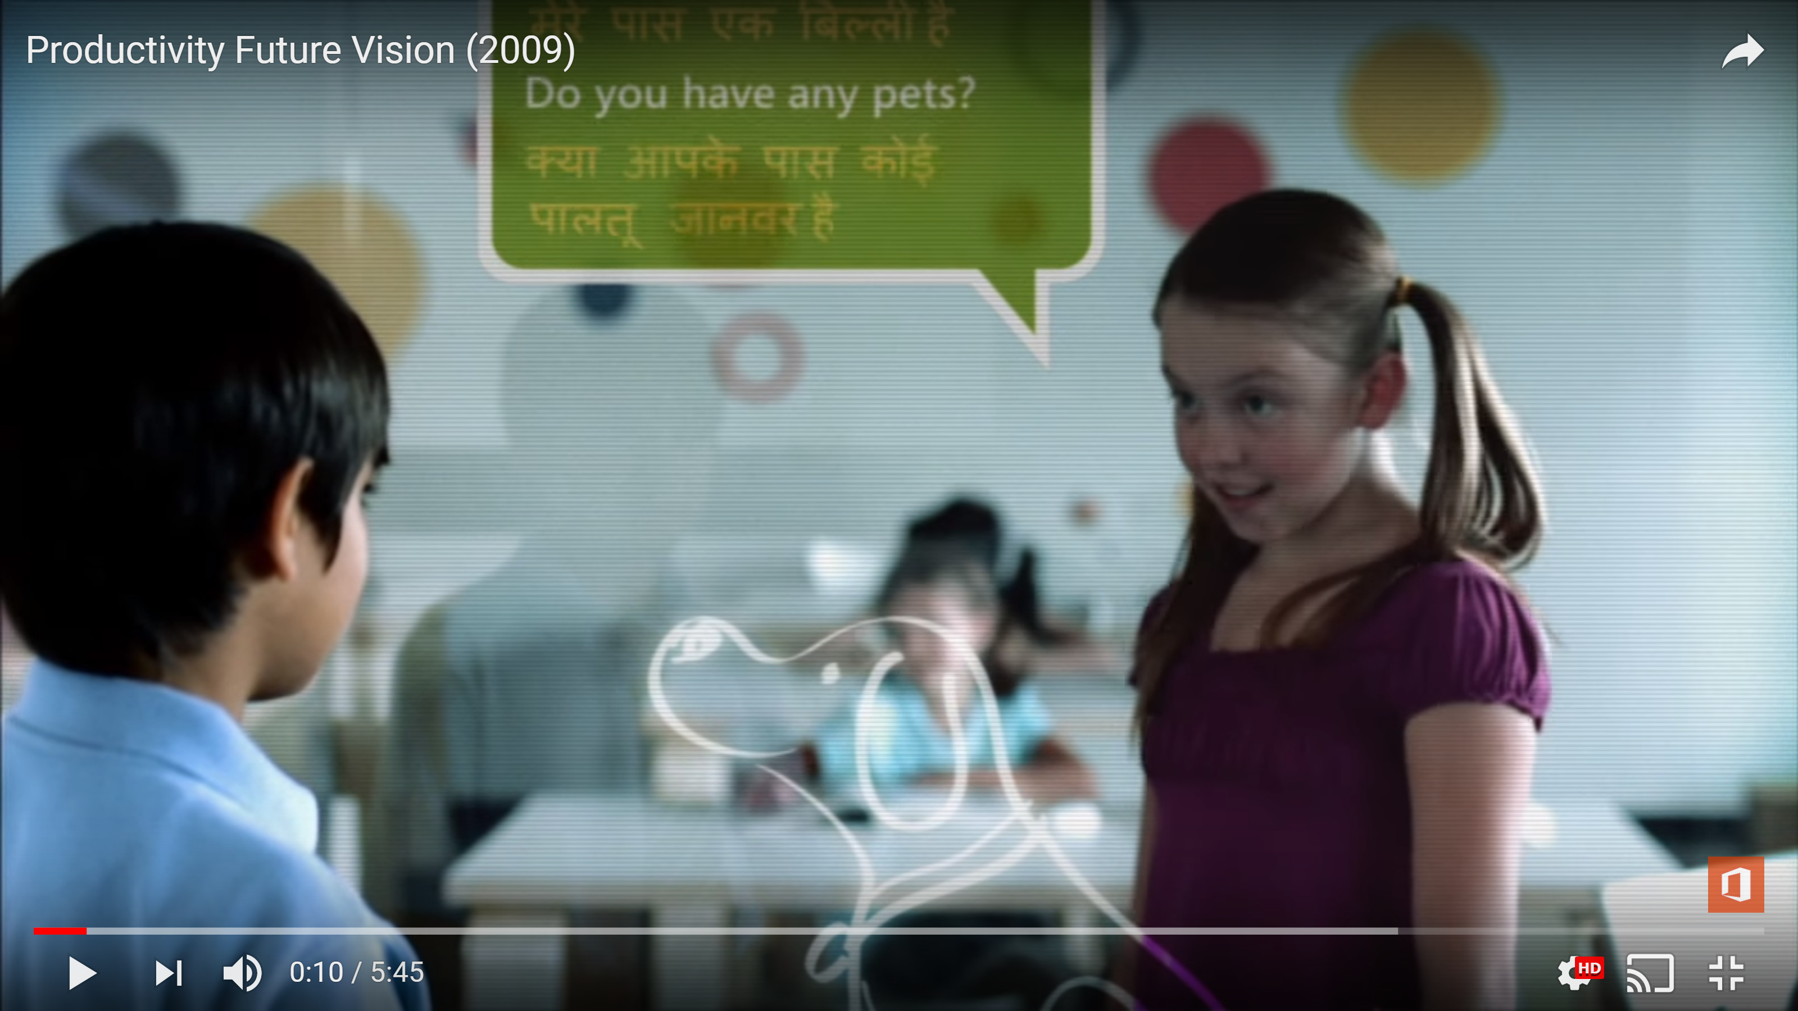
https://www.youtube.com/watch?v=t5X2PxtvMsU
Notes:
https://www.youtube.com/watch?v=t5X2PxtvMsU

Slide 47
Today
Prototyping Augmented Reality / IoT
3-2-1 Process for Prototyping
Slides from Steven Dow
A/B User Testing

Slide 48
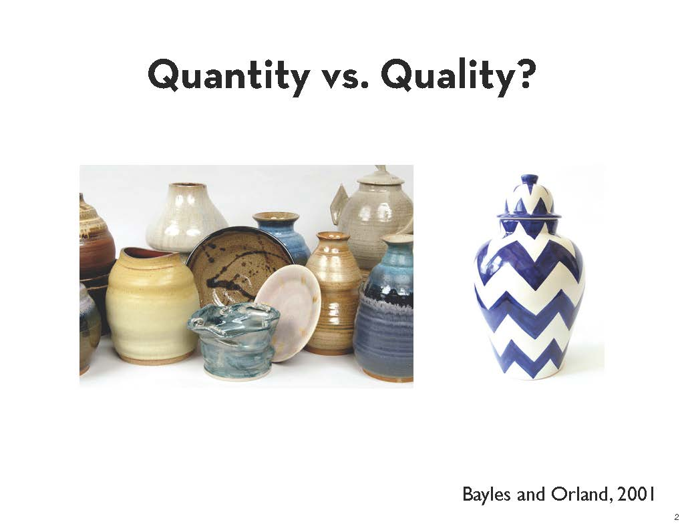
Notes:
Slide from Steven Dow

Slide 49
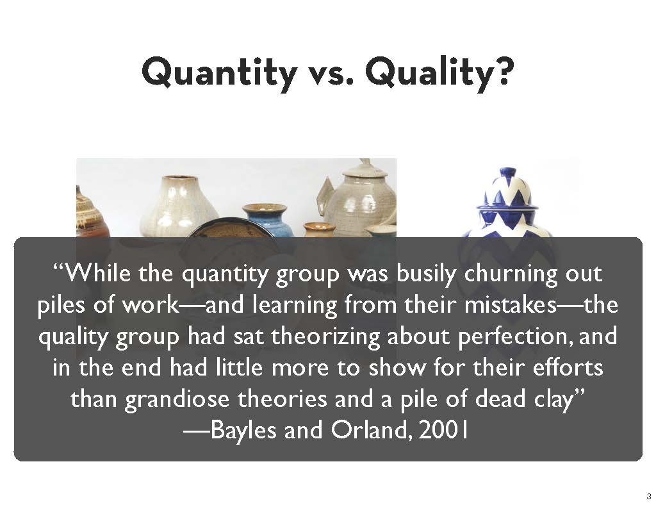
Notes:
Slide from Steven Dow

Slide 50
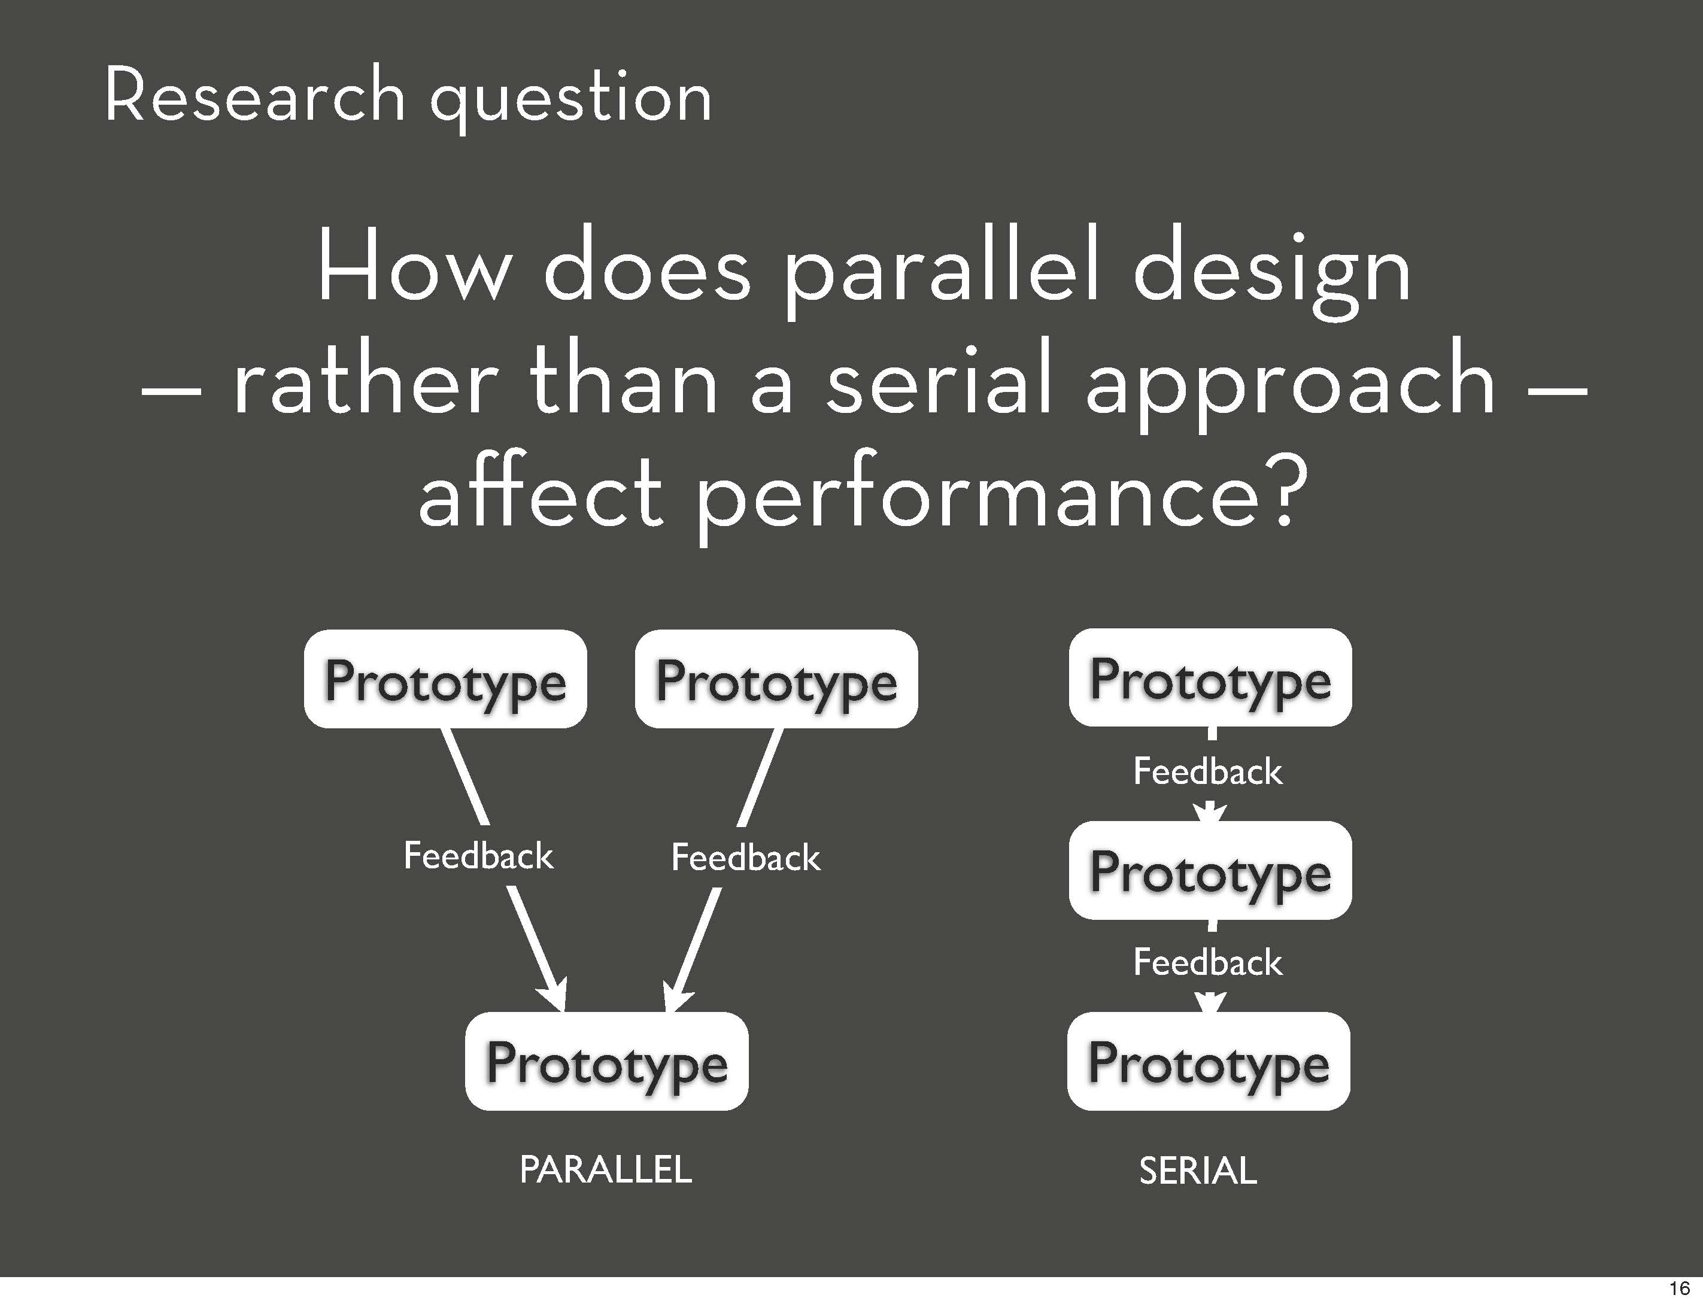
Notes:
Slide from Steven Dow
Previous paper (Tohidi, Buxton, Baecker, sellen, CHI 2006) looked at feedback side of things
What about design side of things? Does it lead to higher quality?

Slide 51
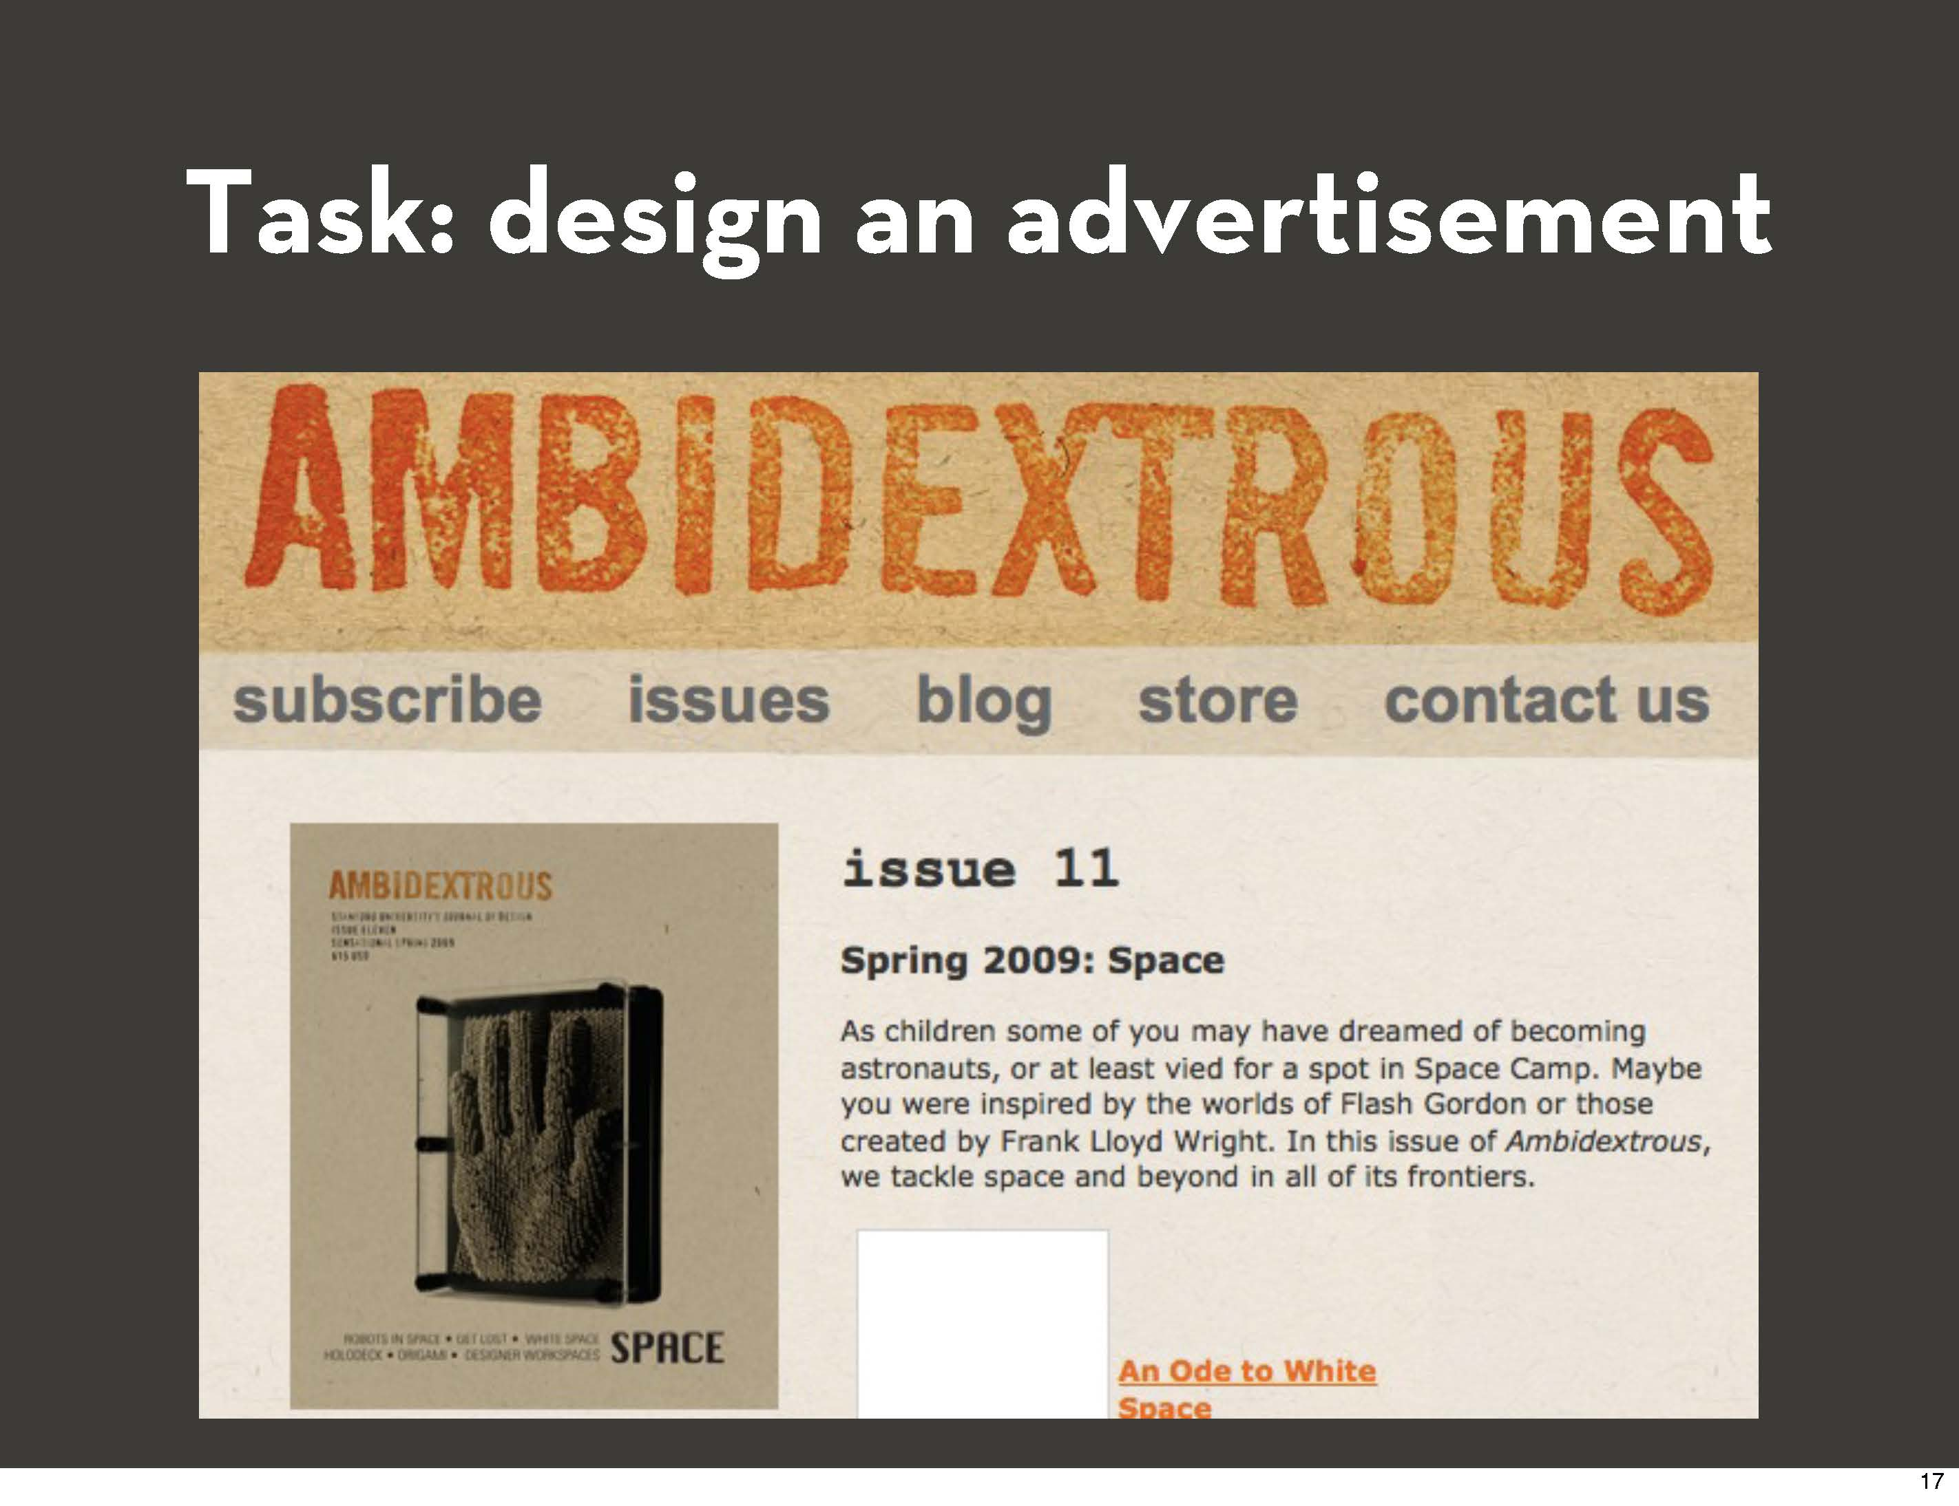

Slide 52
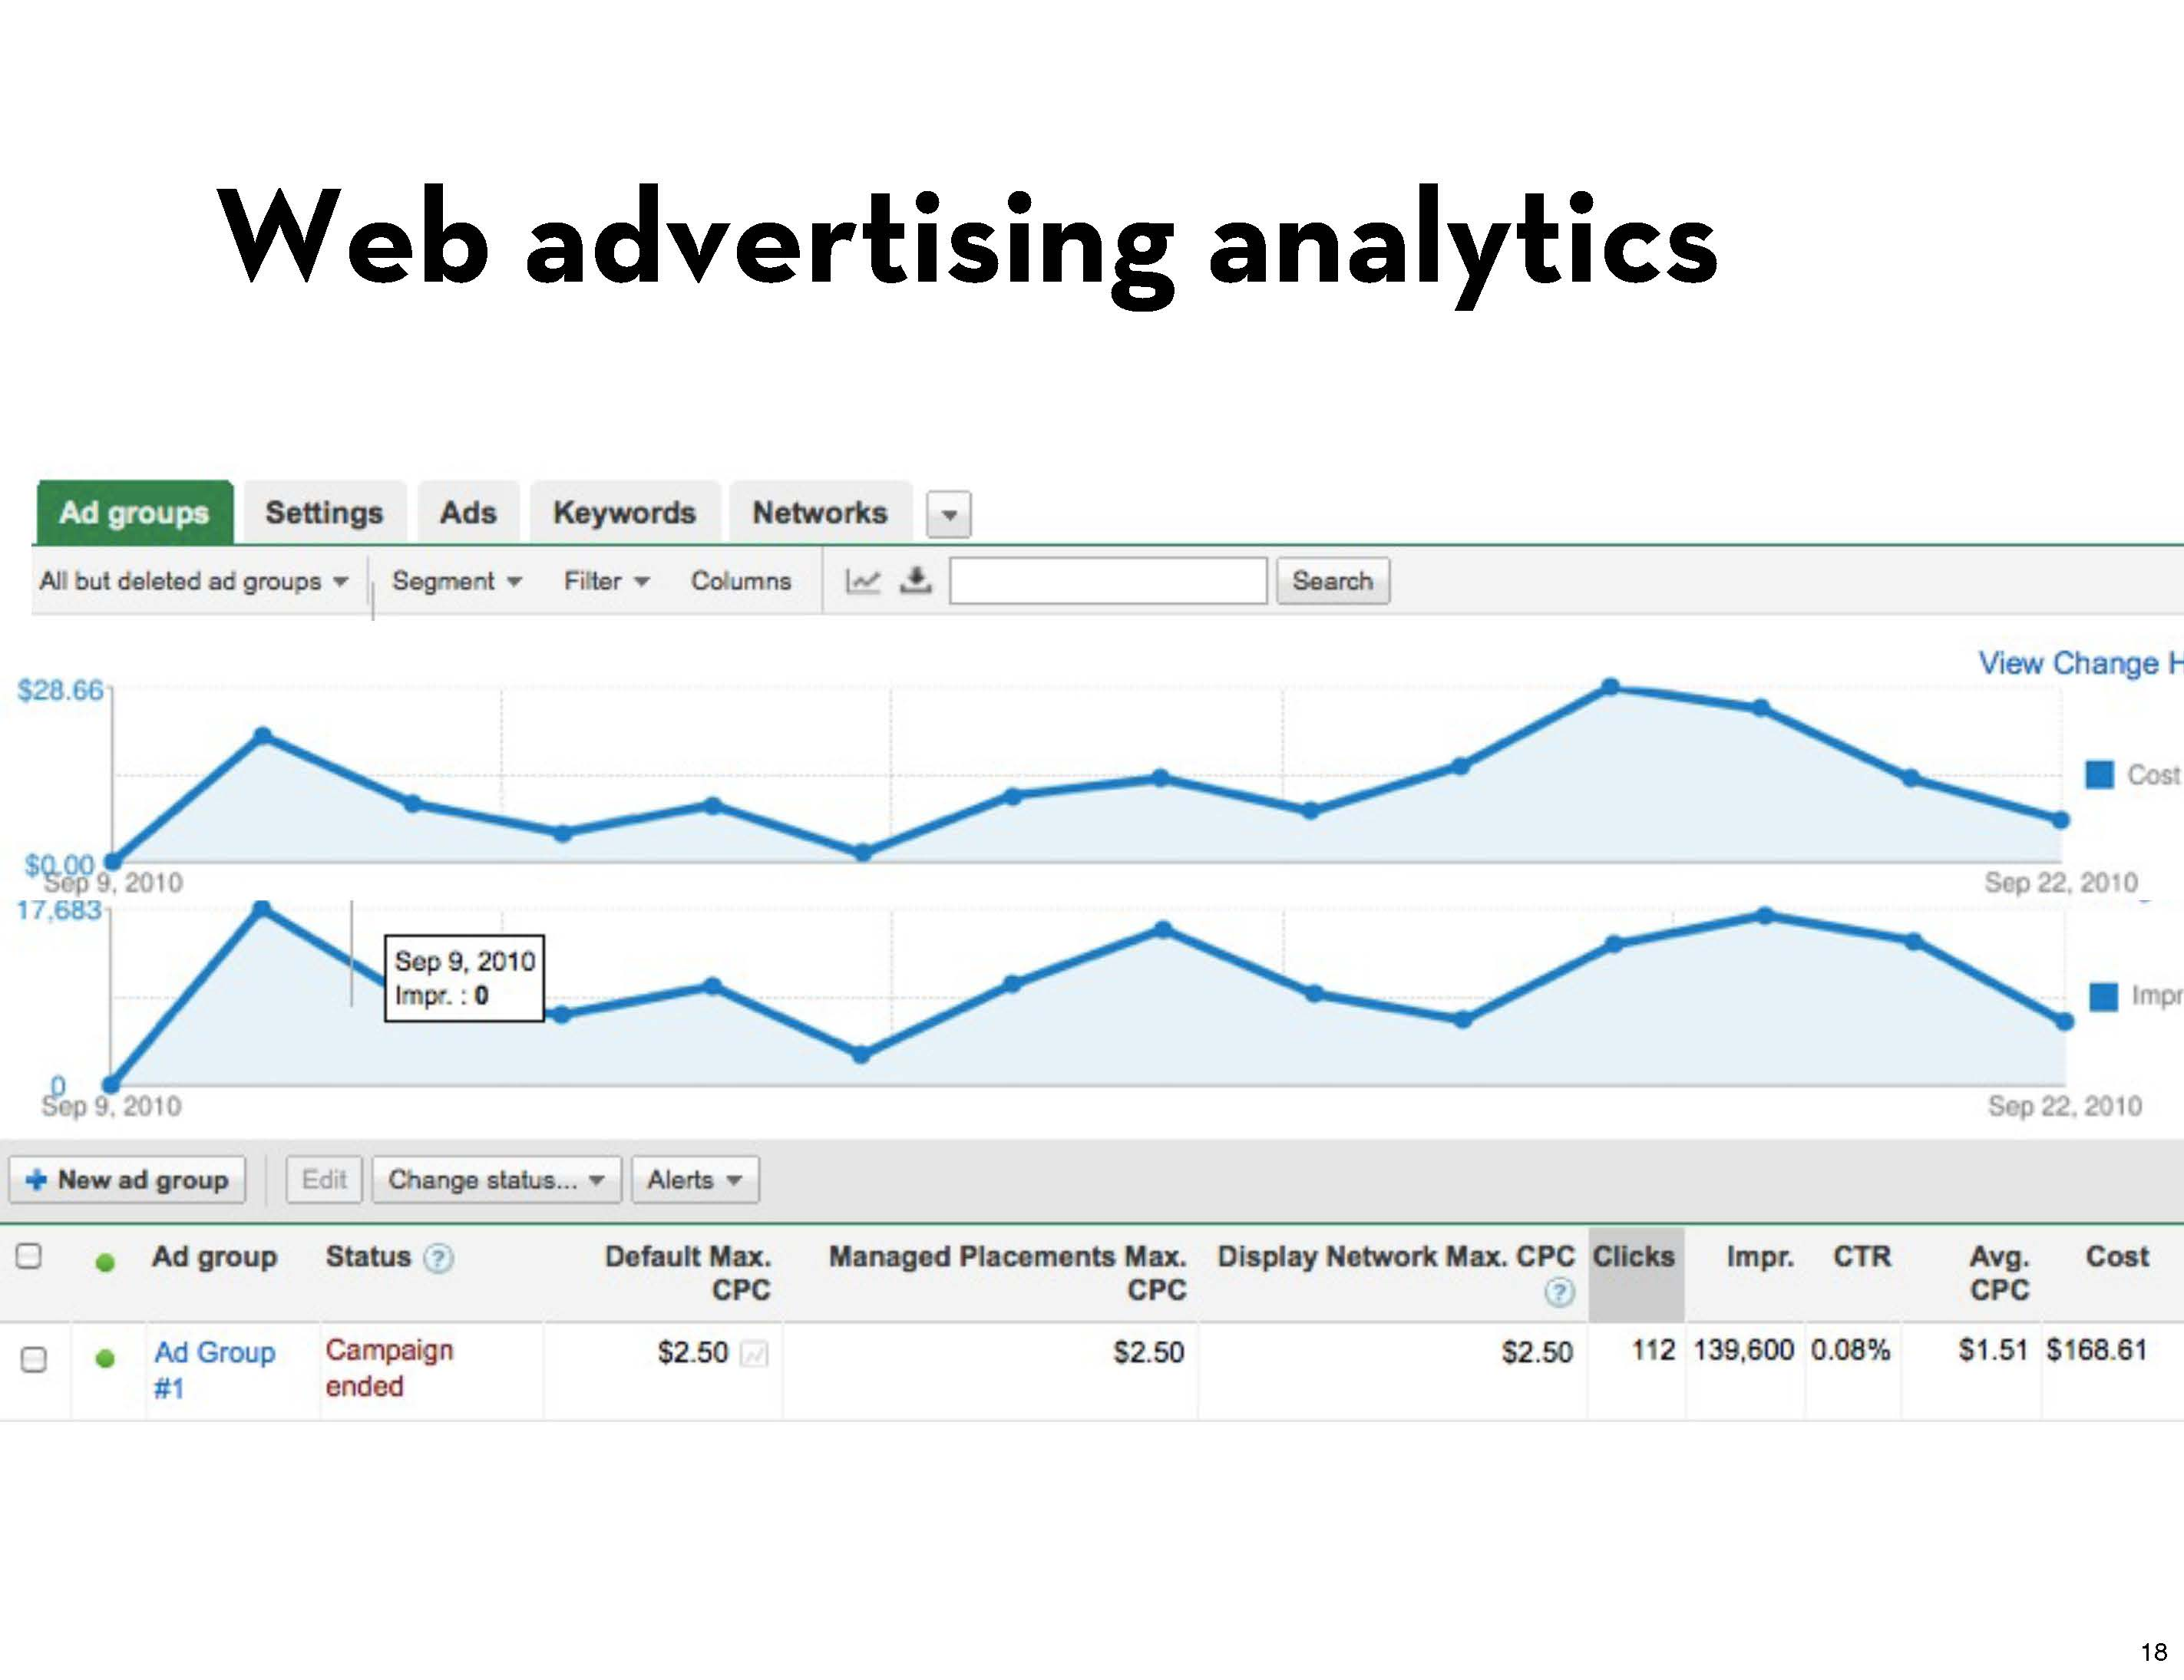
Notes:
Can empirically measure quality by clickthru rates

Slide 53
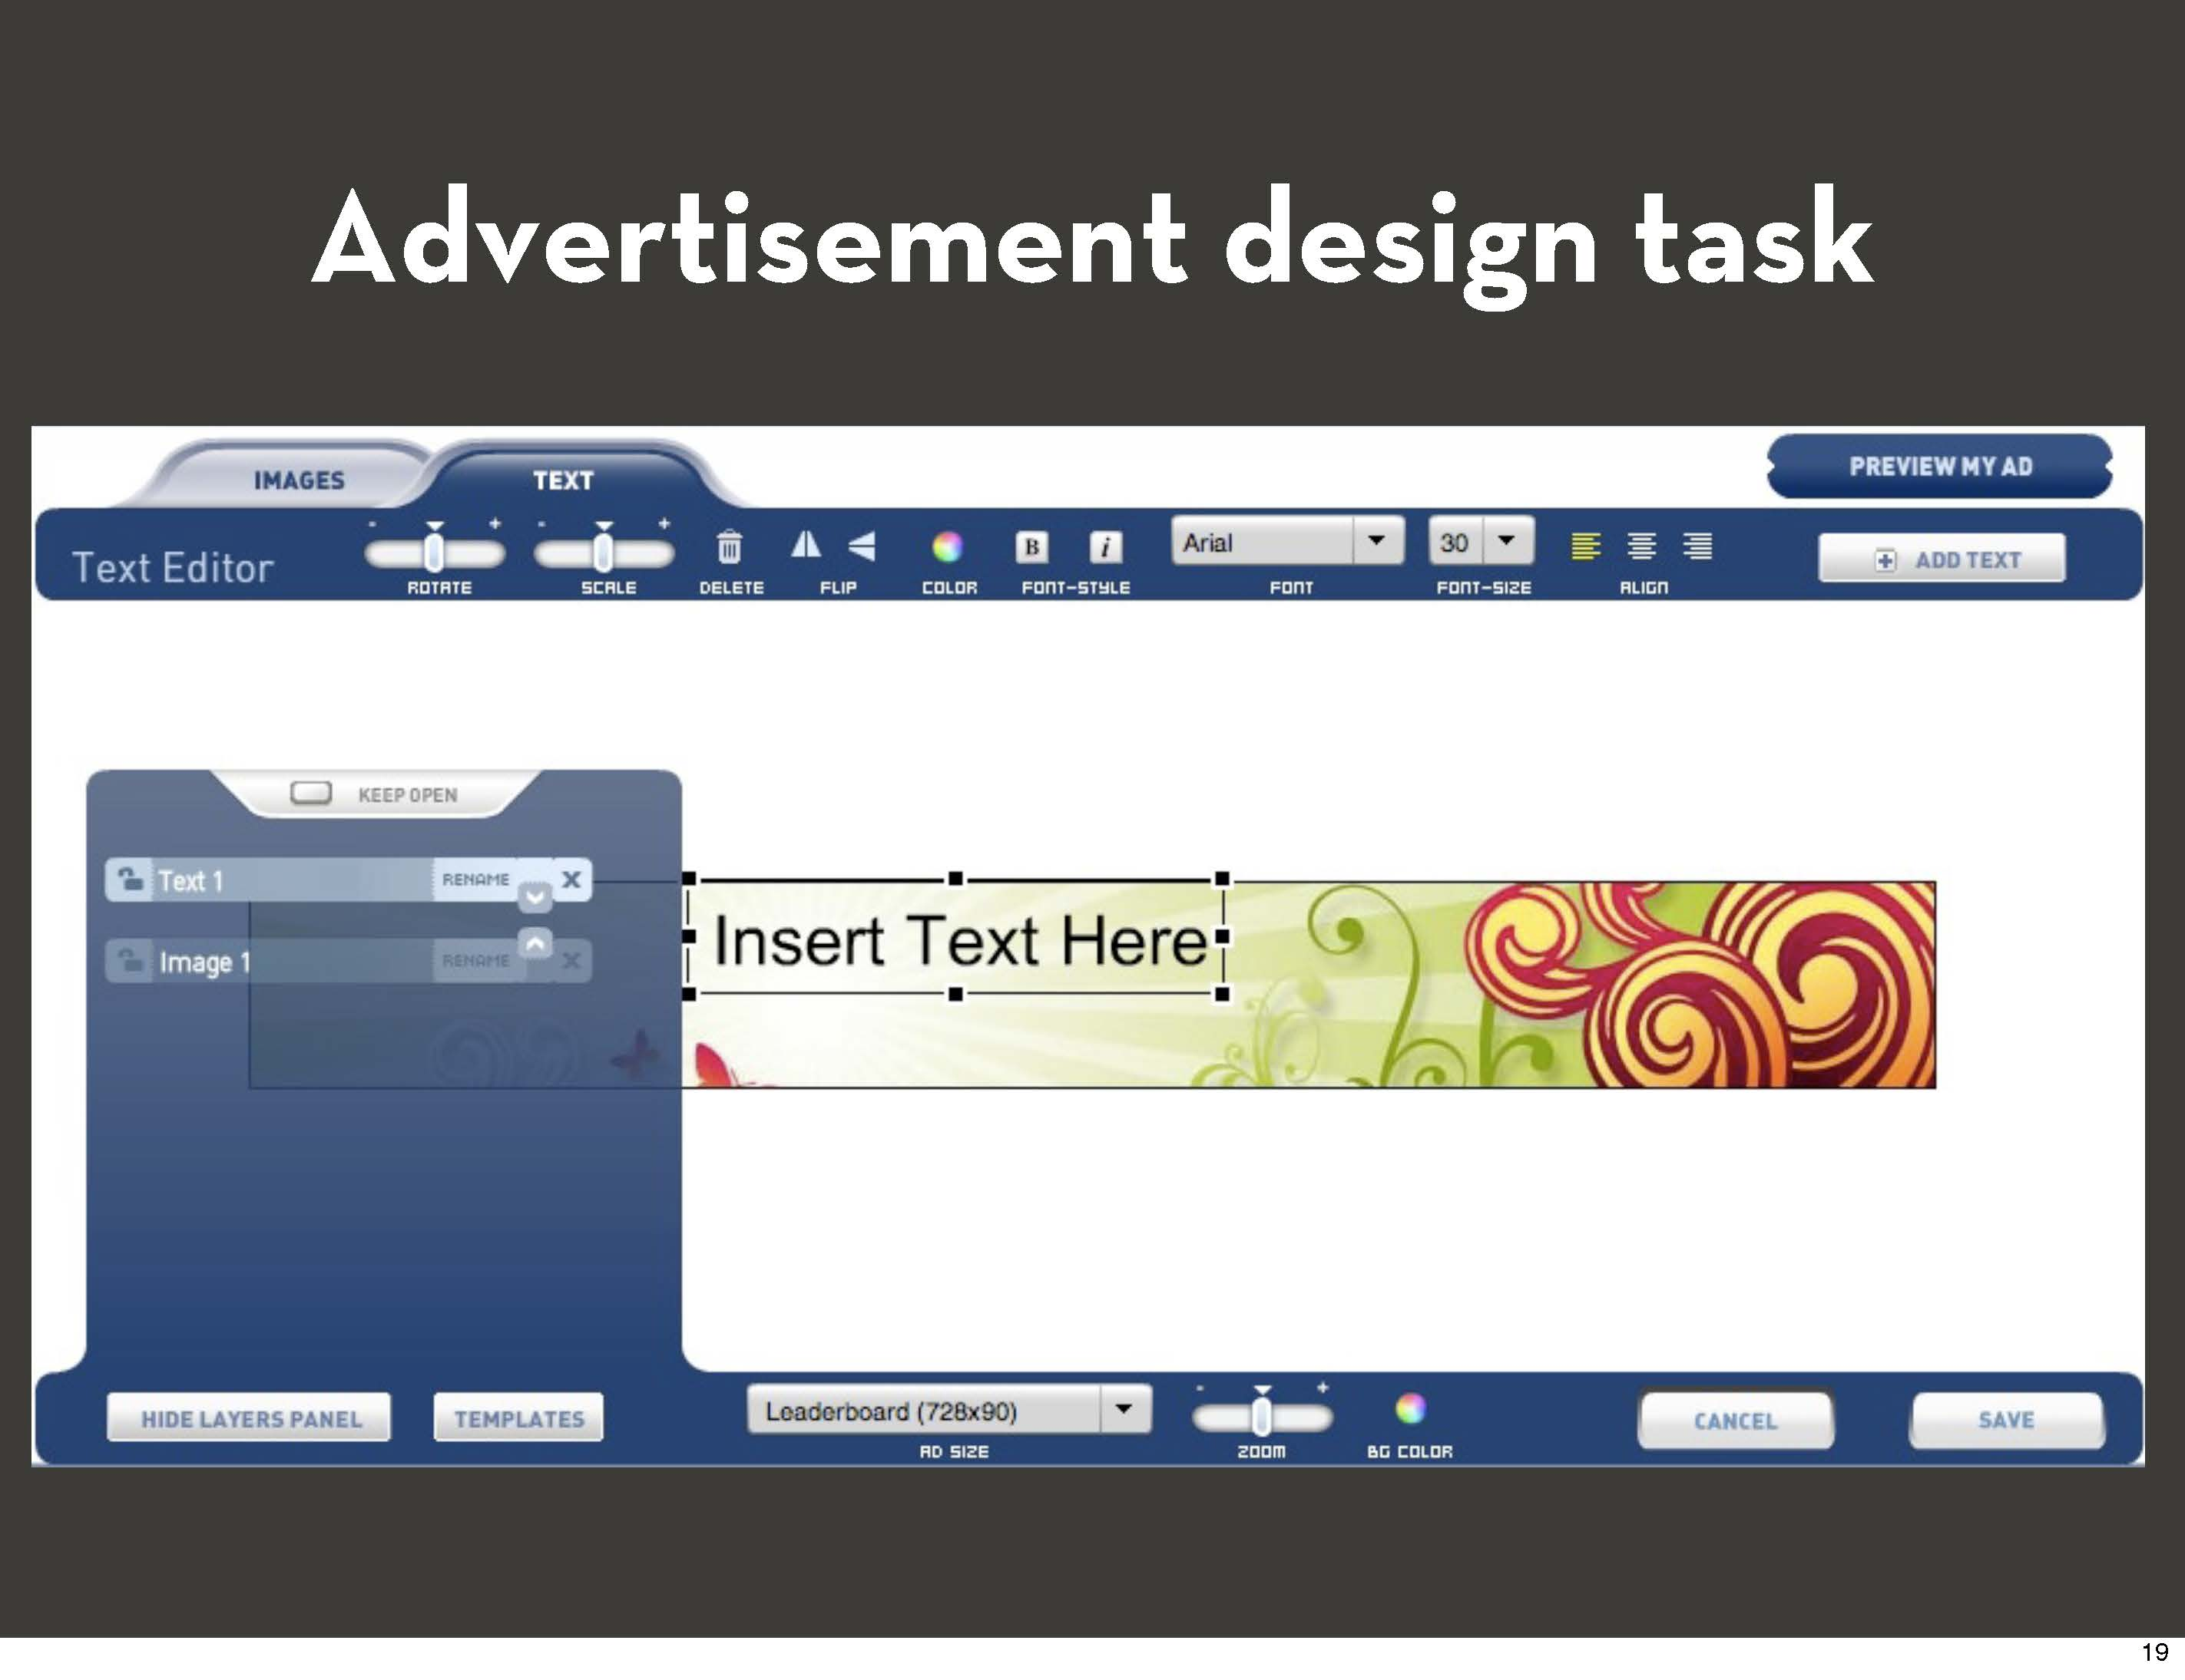

Slide 54
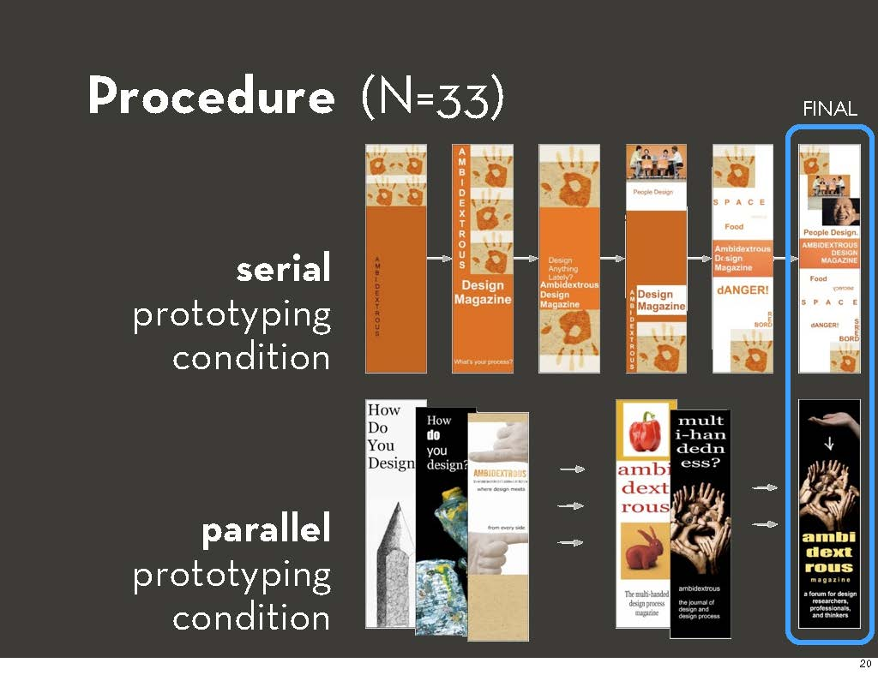

Slide 55
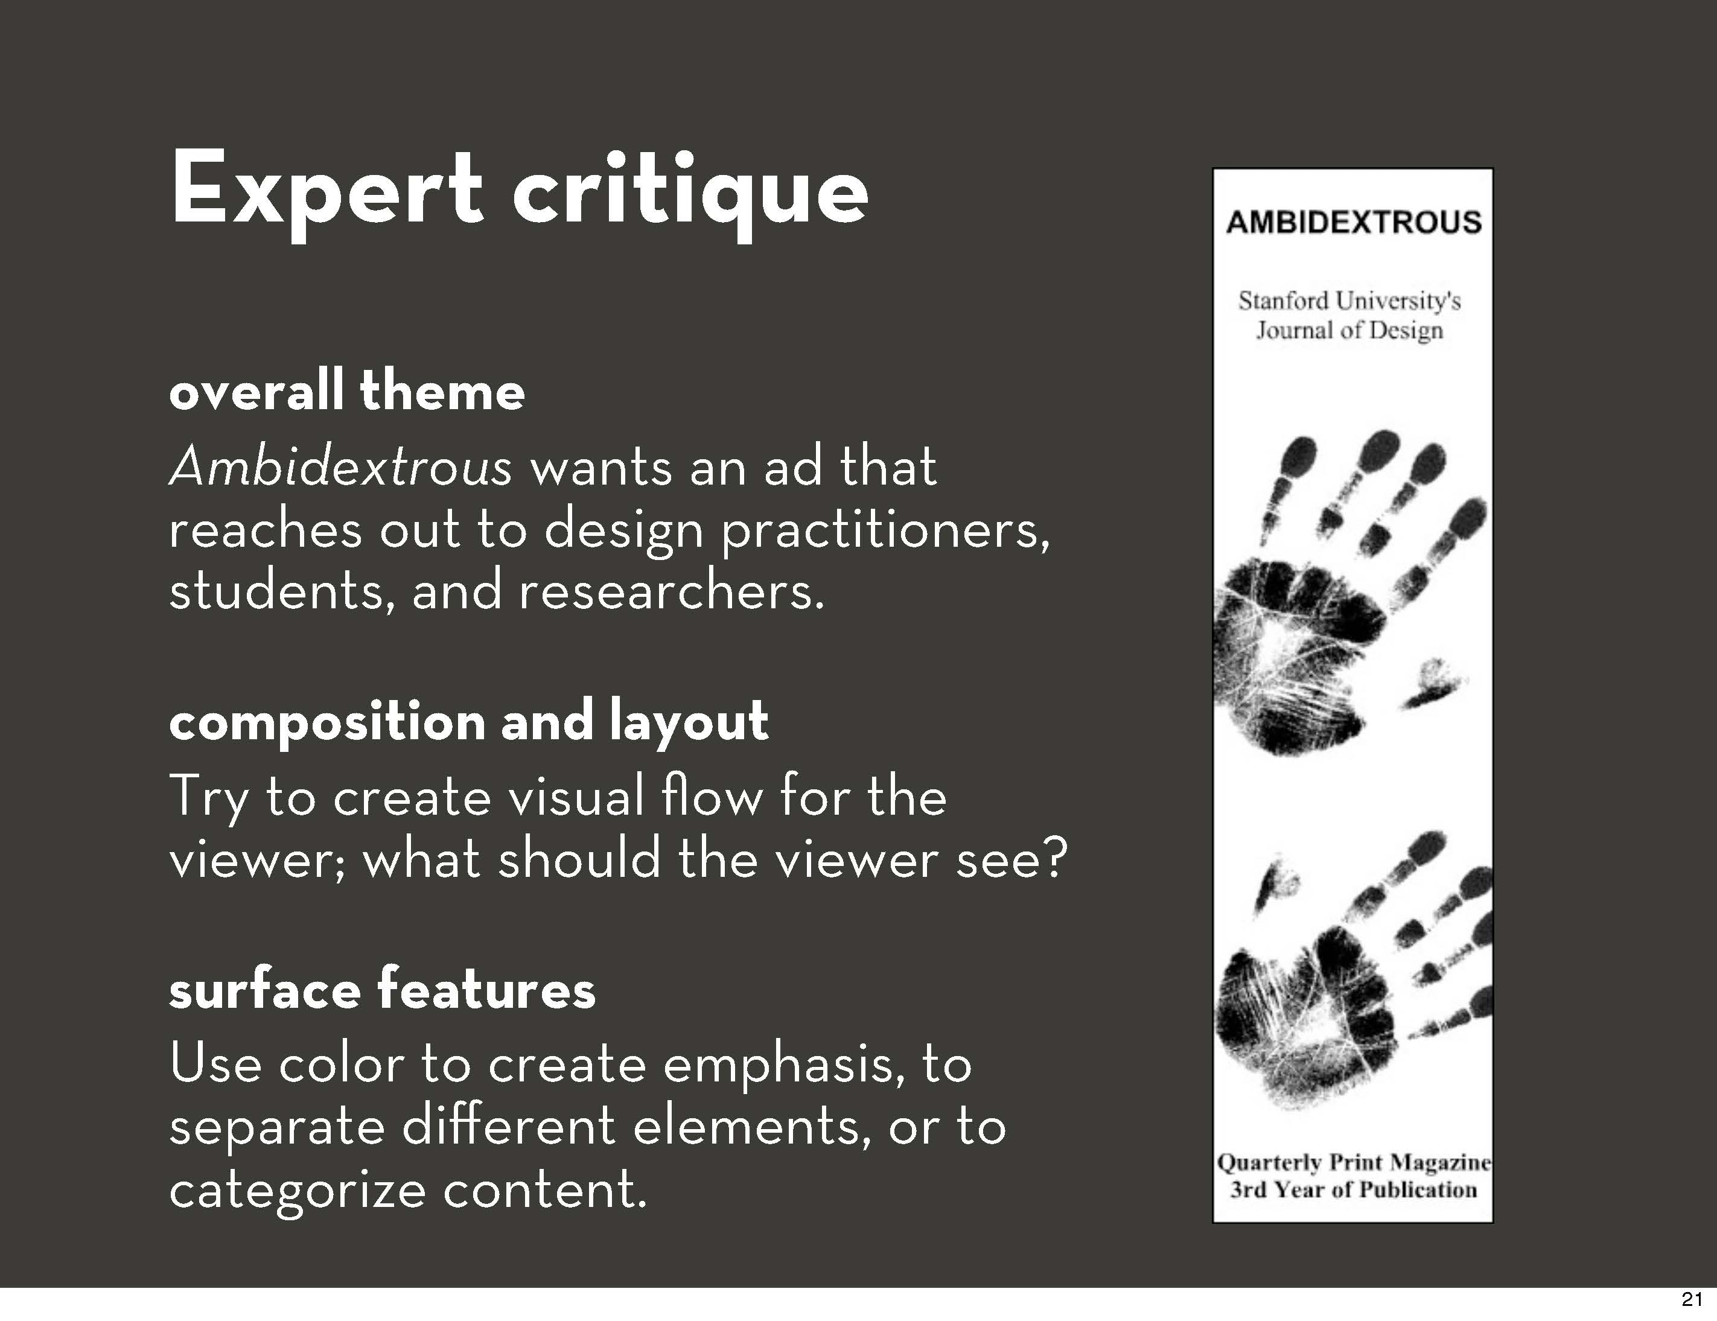

Slide 56
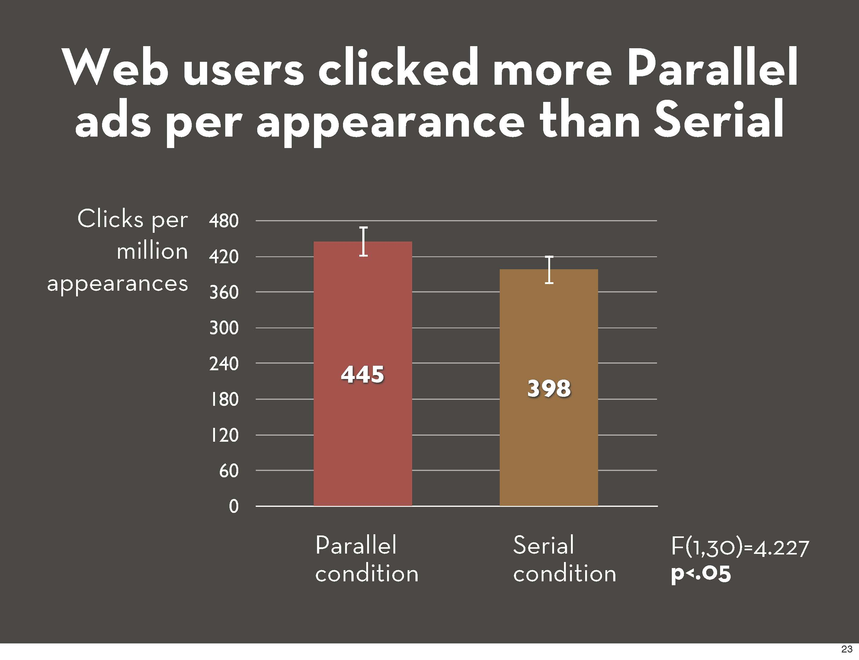

Slide 57
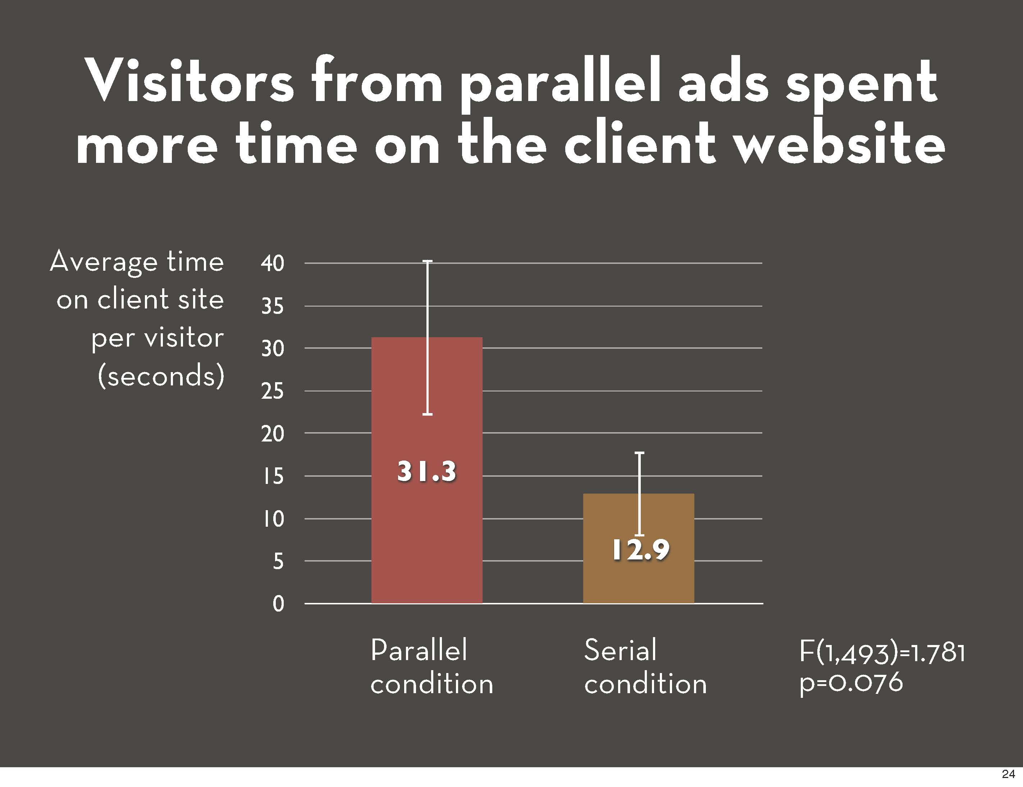

Slide 58
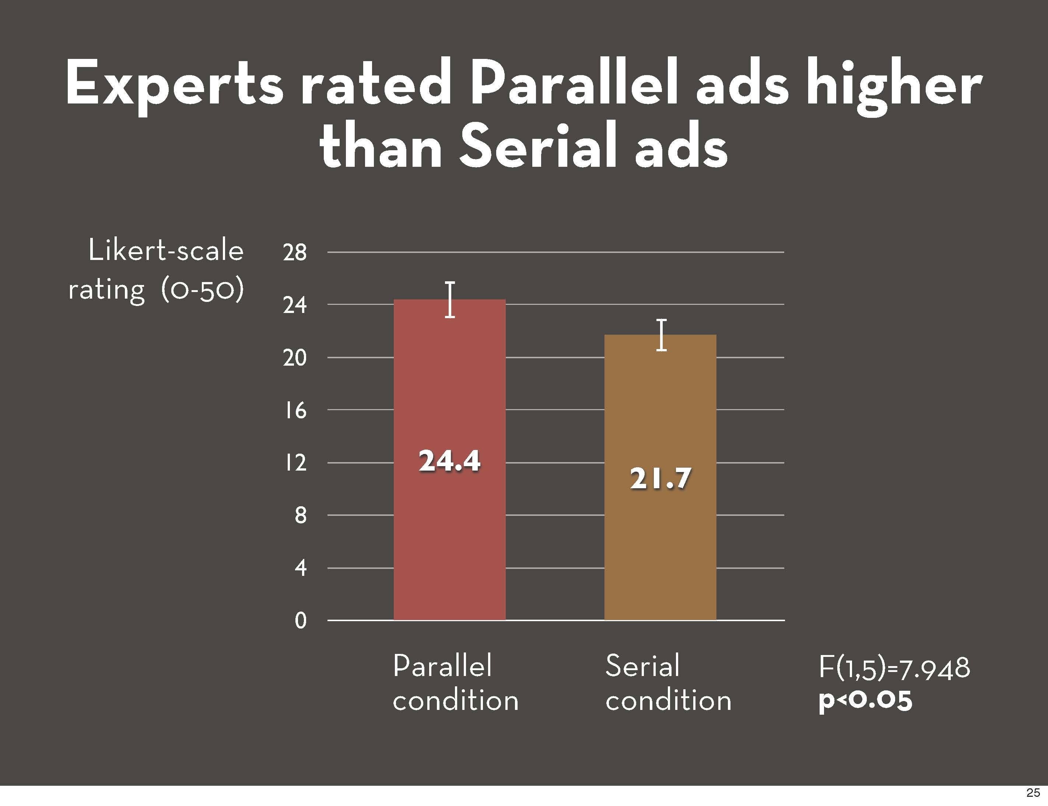

Slide 59
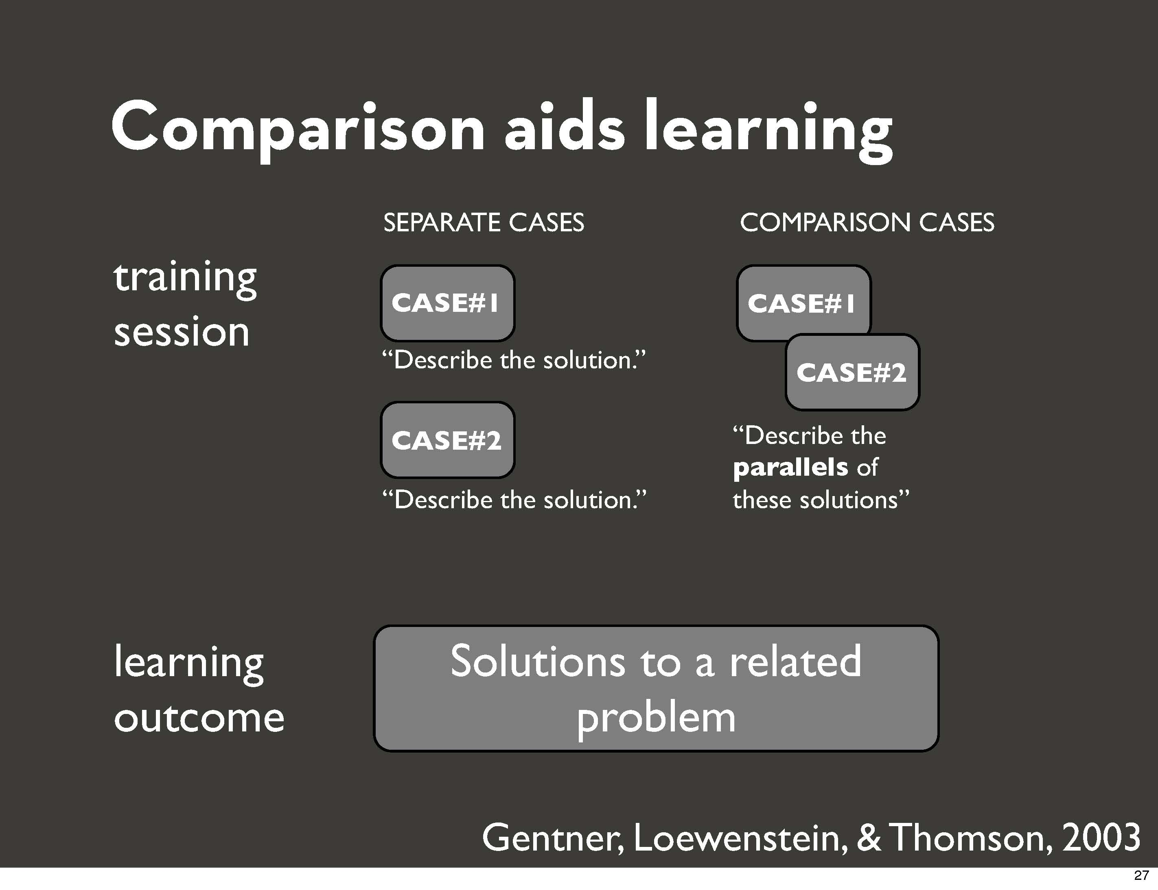

Slide 60


Slide 61


Slide 62


Slide 63

Notes:
Similar to Tohidi study mentioned earlier, more evidence that parallel is better

Slide 64


Slide 65


Slide 66


Slide 67


Slide 68


Slide 69


Slide 70


Slide 71


Slide 72


Slide 73
From a Previous PUI Student
“I was surprised by how successful Parallel Prototyping was when I tried it out with this assignment! I noticed that while I was testing the first design, my users were hesitant about giving extremely critical feedback upfront, perhaps because they didn’t want to hurt my feelings. However, when I showed them a second prototype, they relaxed, as it was no longer about my feelings but the comparison between the two sets of designs. Both users listed pros and cons of each design, giving me extensive feedback on what aspects of my designs I should iterate on.”

Slide 74

Evaluating Variations with A/B Testing
1. Advertise your business on Google
2. Get new customers with Google
3. Connect with new customers
4. Attract more customers
5. Reach new customers
Slides adapted from Dan Russell at Google

Slide 75
N = 1.5M
Advertise your business on Google | 0.0% (original)
Get new customers with Google | -0.37%
Connect with new customers | +0.55%
Attract more customers | +0.67%
Reach new customers on Google | +0.75%

Slide 76

Six Variations on a Text Label n=100k trials / variation, t = 1 week
Sign up now | 0.0% (original)
Begin | +21.3%
Let’s get started | +14.9%
Click to start | +23.7%
Start now | +15.4%
Click to begin | +24.4%

Slide 77
Big Data Changes UX Evaluation
UX data used to be small in quantity, hard to collect, but easy to analyze
Now, with web-based apps, we can collect lots of data and run thousands of experiments
What happens when you change the background color of a UI?
What is the influence of UI components?
Which font style is best, sans vs. serif ?
Notes:
These slides from Dan Russell

Slide 78
Big Data Changes the Way We Think About Behavior
The intuition of a design can often be wrong
Very small changes in UI (trivial ones!) can have massive effects on use
Constant feedback in a web-app world allows for fast iteration and evolution

Slide 79

79
Notes:
79
Sometimes the information that users are looking for is related to a particular place - like the all-night doughnut shop that's nearest to your house. Google stores neighborhood information, Yellow Page data, and map data, and cross-check that information to give users access to the most relevant local results.
Note that this UI has local info on the RHS. We changed this… it’s now on the LHS (because we found that a large number of people never saw it on the right!) The CTR was down over what we’d expected… or wanted.

Slide 80

80
Notes:
80
Note other changes to the UI – Details tab on site; print/email/link in upper right; more pizza places!

Slide 81

81
Notes:
Slide from Jan 16, 2009
81

Slide 82

Which UI Performs Better in Terms of Conversion Rates
A
B
Remove, then +6.5%
Example from Bryan Eisenberg, www.clickz.com/showPage.html?1588161

Slide 83





Which UI Performs Better in Terms of Conversion Rates
18.6% better
Notes:
http://blog.optimizely.com/how-obama-raised-60-million-by-running-an-exp

Slide 84
Discussion: Pros and Cons of this kind of A/B testing?
Premature optimization
Don’t have insight as to why
But do know it’s real user behavior
Test only one variable at a time
Can improve retention rates / conversions
Can get stuck in getting design right
Can be misleading if A/B comparisons aren’t good comparisons
Can be easy to compare options (especially once you have your metrics)
Need lots of people to do A/B tests
Can overoptimize things / lack of consistency
Notes:
Makes designers HATE HATE HATE HATE
No flexibility
A/B testing can get to local optimal solution, but not necessarily to customers’ hearts
See Jeff Atwood’s Groundhog day
Easy to do tests to confirm / reject hypothesis
Not clear why something is better / worse
Baseline / minute changes / local optimal vs global / also stuck with the same look and feel / corporate culture
Exponential plus plus plus options / might be choosing bad and worse
Doesn’t cater to variety / one size fits all
Real data about what users do / engineers

Slide 85

41 Shades of Blue
A designer… had picked out a blue that everyone on his team liked. But a product manager tested a different color with users and found they were more likely to click on the toolbar if it was painted a greener shade… [the team was asked] to test the 41 gradations between the competing blues to see which ones consumers might prefer.
NYTimes “Putting a Bolder Face on Google” Feb 28 2009
Notes:
http://www.nytimes.com/2009/03/01/business/01marissa.html?pagewanted=3

Slide 86

Google Testing 41 Shades of Blue
“Google's engineers apparently couldn't decide on two shades of blue for showing search results, so they tested 41 of them to see which attracted the most clicks. ” - FastCoDesign
Notes:
From http://www.slideshare.net/andrew_null/metrics-driven-design-by-joshua-porter/9-Doug_Bowman_on_Design_at
https://www.fastcodesign.com/1662273/google-equates-design-with-endless-testing-theyre-wrong

Slide 87
41 Shades of Blue
“Yes, it’s true that a team at Google couldn’t decide between two blues, so they’re testing 41 shades between each blue to see which one performs better. I had a recent debate over whether a border should be 3, 4 or 5 pixels wide, and was asked to prove my case. I can’t operate in an environment like that. I’ve grown tired of debating such minuscule design decisions. There are more exciting design problems in this world to tackle.”
http://stopdesign.com/archive/2009/03/20/goodbye-google.html

Slide 88
Summary and For Next Class
When designing for AR and IoT, have to be really creative in early stages of design
3-2-1 approach for prototyping
Design patterns
Browse through these two sites before class:
User Interface Design Patterns Library http://ui-patterns.com/patterns
Android Patterns http://unitid.nl/androidpatterns/
Notes:
User Interface Design Patterns Library /
Android Patterns

Slide 90
Summary

Slide 91
Slogan
Every UI should have basic instrumentation built into it as part of best practice
expectation should be that we UX practitioners need to look at the real behavioral use data
users will expect data to flow back from the app to some collection point in the sky (and expect the UI to change over time)
Notes:
91

Slide 92


Slide 93

Notes:
Picture is from the great book Universal Methods of Design. http://www.amazon.com/Universal-Methods-Design-Innovative-Effective/dp/1592537561
Here’s another method for understanding, by putting yourself in the shoes of the user in real-world situations.
You are not the user, but you can simulate things to put yourself in their shoes as much as you can.
For example, here at the bottom-right you can see a picture of people trying out walkers, typically used for people with low mobility. Trying it out, experiencing it for yourself, really feeling it in your gut, is a powerful way of getting a deep understanding of things. In the middle, you can see some people wearing “age suits” which simulate difficulties in moving one’s body. These people are seeing firsthand what it feels like to go shopping if you have mobility constraints.
Sometimes, for simulation exercises, you really have to be creative in faking it. For example, I heard a story about a design firm trying to design for submarines. The participants were non-designers, and were doing brainstorming in a nice air-conditioned hotel conference room. One of the designers convinced the folks to stuff themselves into an elevator and do all of the brainstorming there, to get a better sense of what things would be like in cramped and claustrophobic conditions.

Slide 94


Slide 95
Cultural Probes
Originally created as a hybrid of art + design
Provoke inspirational responses
Understanding a different culture
Understanding people’s feelings
Useful if you want to get information over a long period of time

Slide 96

Cultural Probes
Increase presence of elderly in community
“We’ve brought you a kind of gift. They’re a way for us to get to know you better, and for you to get to know us. Take a look, and we’ll explain what’s in them.”
Notes:
we were there as part of a European Union–funded research project looking at novel interaction techniques to increase the presence of the elderly in their local communities

Slide 97

Cultural Probes
Postcards
What do you dislike about [village]?
What place does art have in your life?
Tell us about your favorite device

Slide 98

Cultural Probes
Maps
Where have you been in the world? (world map)
Where you like to go meet people? (local map)
Where you like to go to be alone?
Where you would like to go but can’t?
Disposable camera
Your home
First person you see today
Something fun
Something boring

Slide 99

Cultural Probes
Photo Album
Use 6-10 pictures to tell us about your story
Media Diary (daily for a week)
Record TV and radio use
Record what they watched, when, and with whom
Record incoming and outgoing calls
Unexpected use
When team went in person to give probes to groups, the probes sparked a lot of useful discussion as well

Slide 100
Discussion: Cultural Probes
Pros and Cons of cultural probes?
- Time intensive
+ Building trust / goodwill
+ Can get lots of feelings / emotions that might be hard to capture
+ Can be fun to do / good for people who may have more time
- Self reporting (may be subjective and inaccurate)
+/- Undirected, hard to do task analysis
- Potential for dropouts
+ Inspirational
Notes:
From last time
Relying heavily on what the participants think are important / vs system design perspective
Could be highly subjective / not statistically significant
Needs to be made personal for individuals
Geared towards certain types of people
David’s father doesn’t like postcards
People might not remember to do these things
Capture artifacts that might support diary
From 2016
Potentially time intensive
Local vs global (culture may differ)
Pro: Get out of stereotypes
Pro: Natural habitat
Con: Inappropriate situations (work environments?)
May not always correlate with design
But design inspiration

Slide 101

Flu
Notes:
101

Slide 102

Notes:
102

Slide 103

Notes:
103

